Slide 1
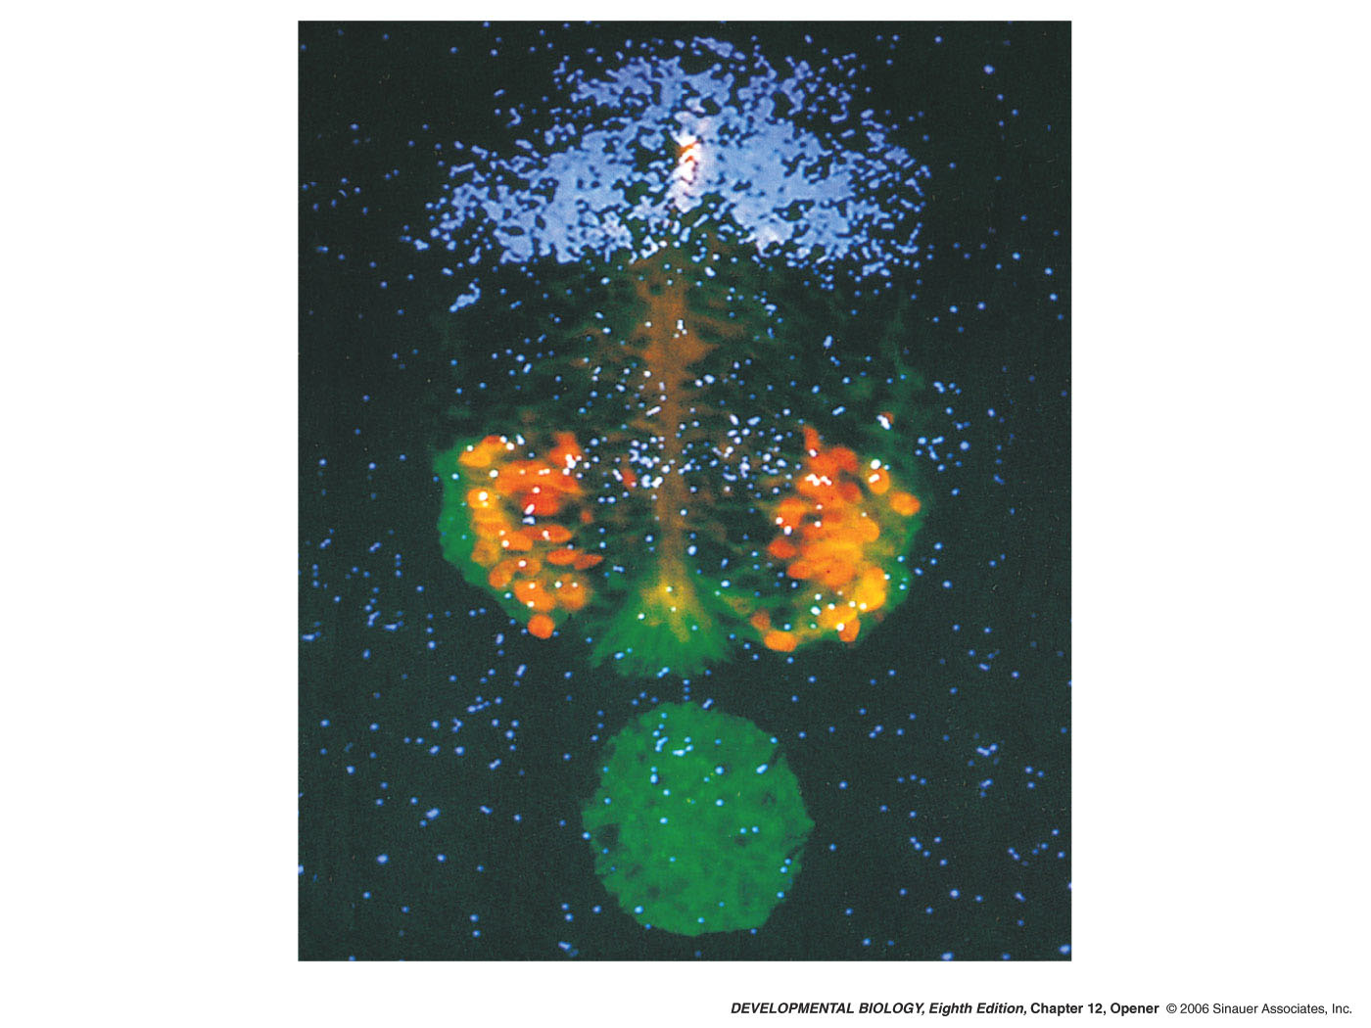
Neurulation Chapter 9 p333-345
Notes:
devbio8e-chptopener-12.jpg

Slide 2
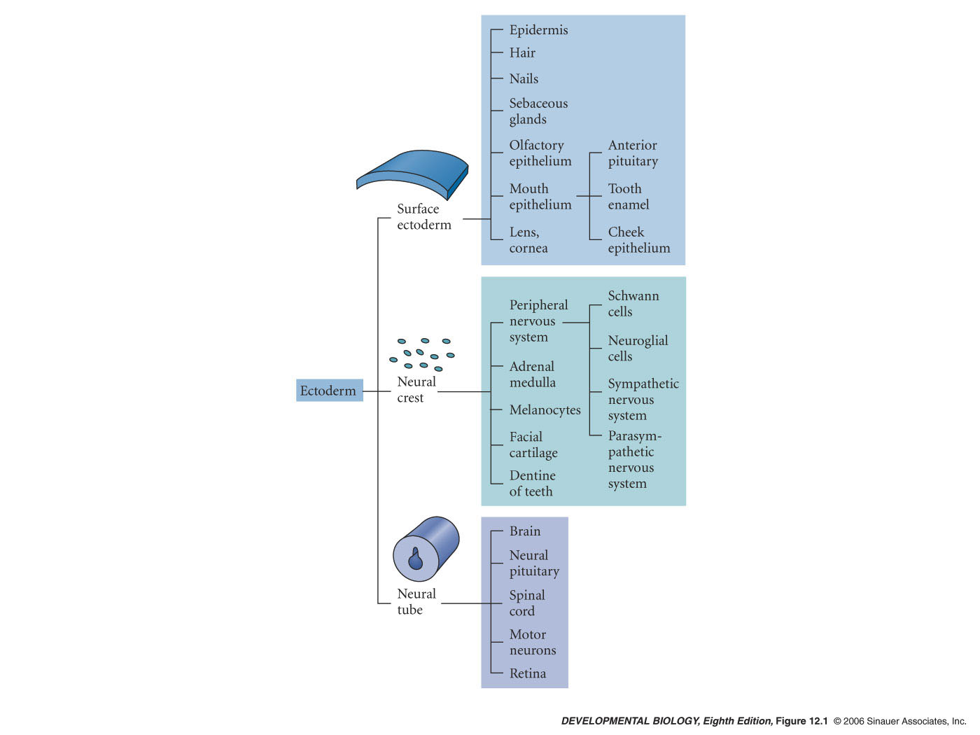
12.1 Major derivatives of the ectoderm germ layer
Notes:
devbio8e-fig-12-01-0.jpg

Slide 3
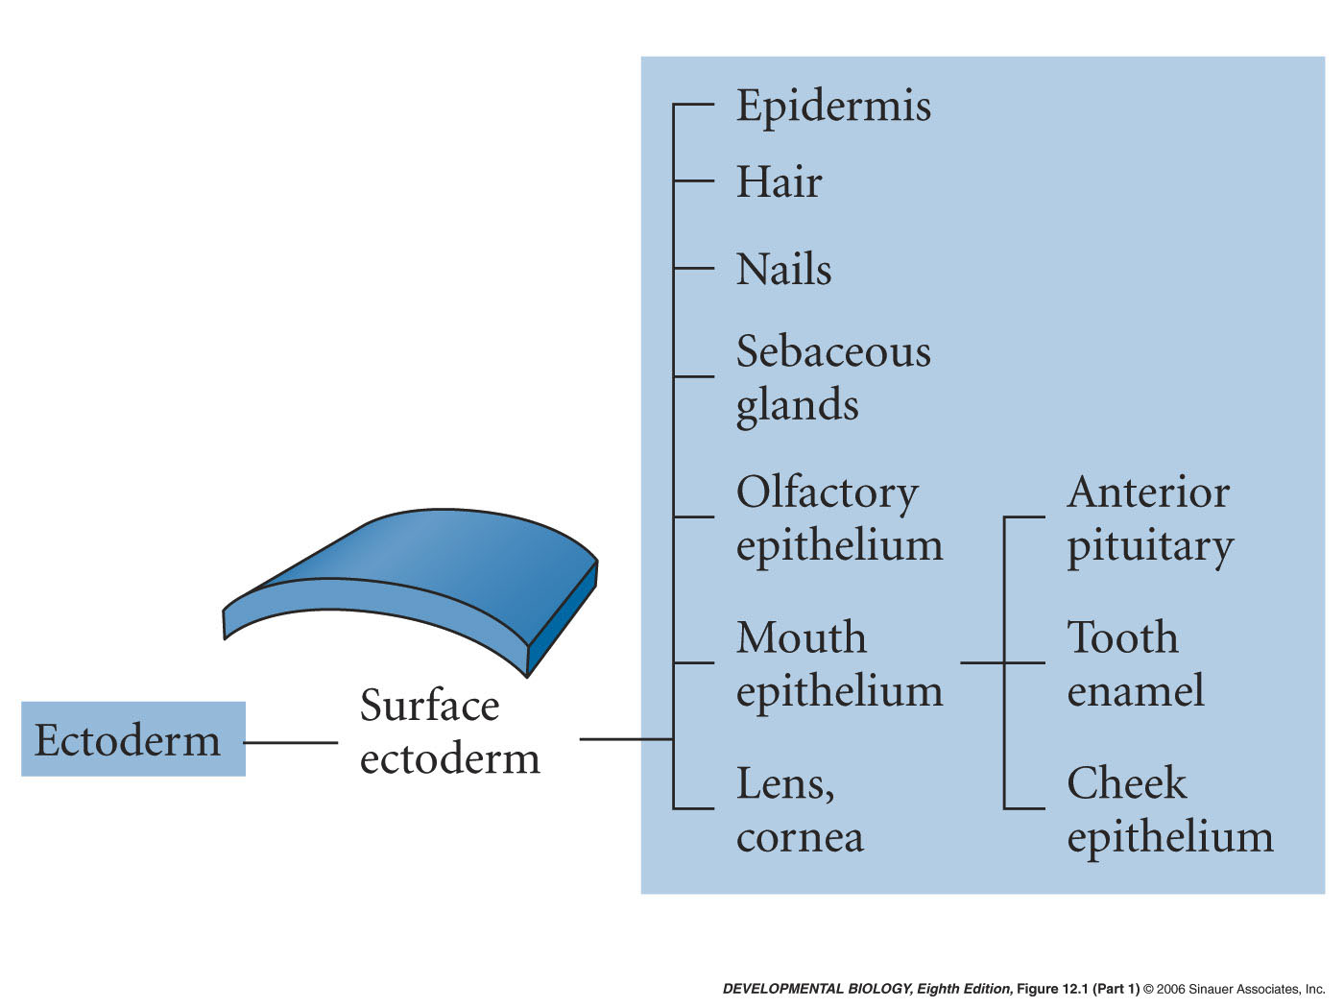
12.1 Major derivatives of the ectoderm germ layer (Part 1)
Notes:
devbio8e-fig-12-01-1.jpg

Slide 4
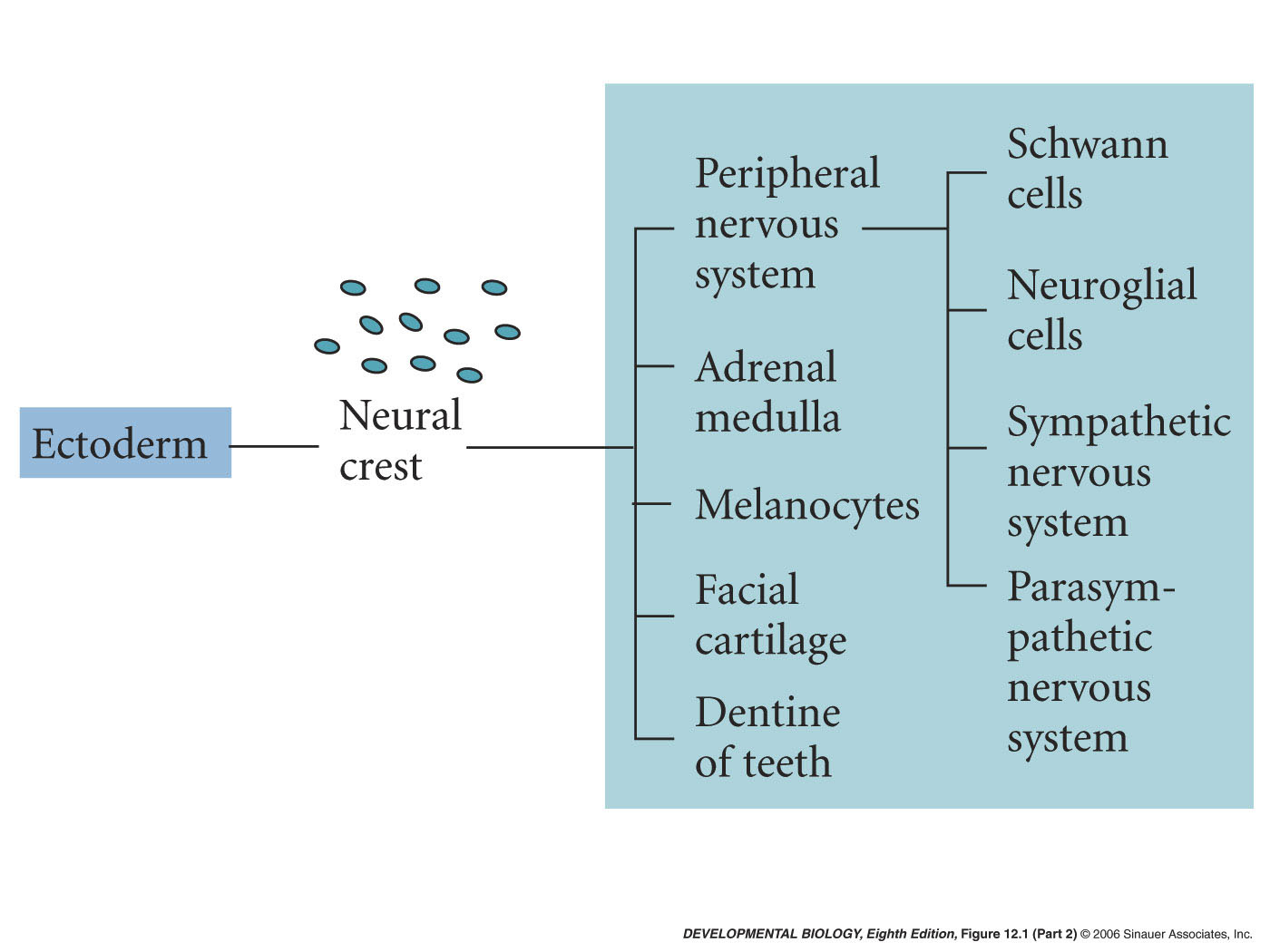
12.1 Major derivatives of the ectoderm germ layer (Part 2)
Notes:
devbio8e-fig-12-01-2.jpg

Slide 5
12.1 Major derivatives of the ectoderm germ layer (Part 3)
Notes:
devbio8e-fig-12-01-3.jpg

Slide 6
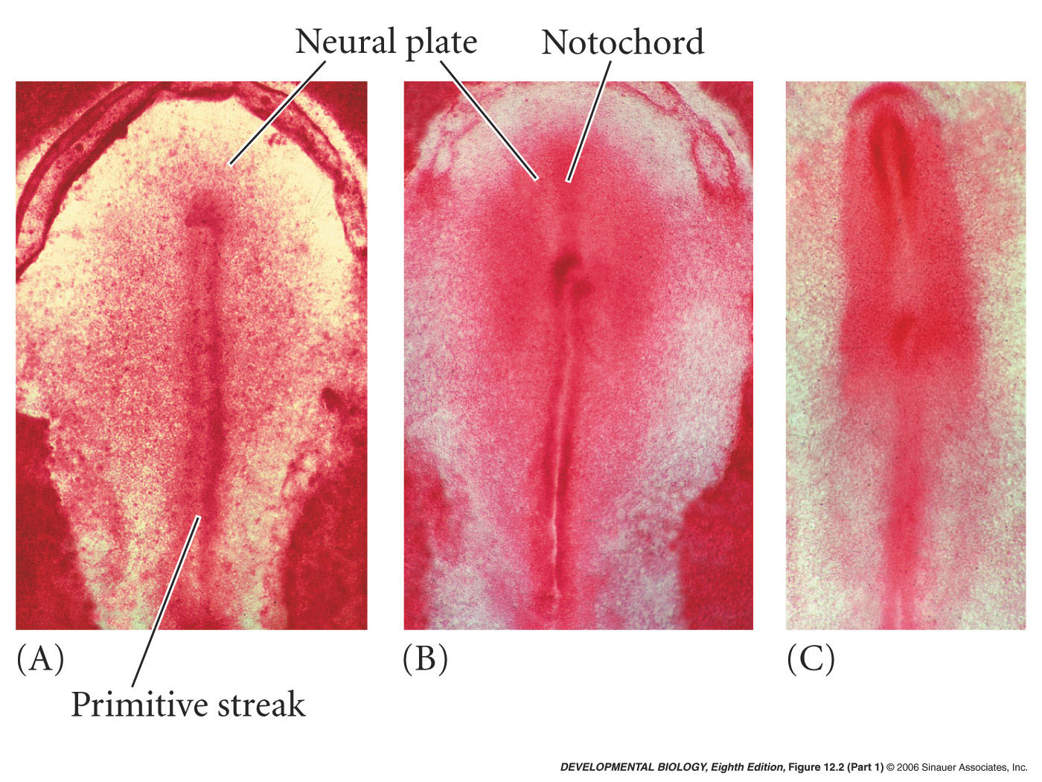
12.2 Neurulation in a chick embryo (dorsal view) (Part 1)
Notes:
devbio8e-fig-12-02-1.jpg

Slide 7
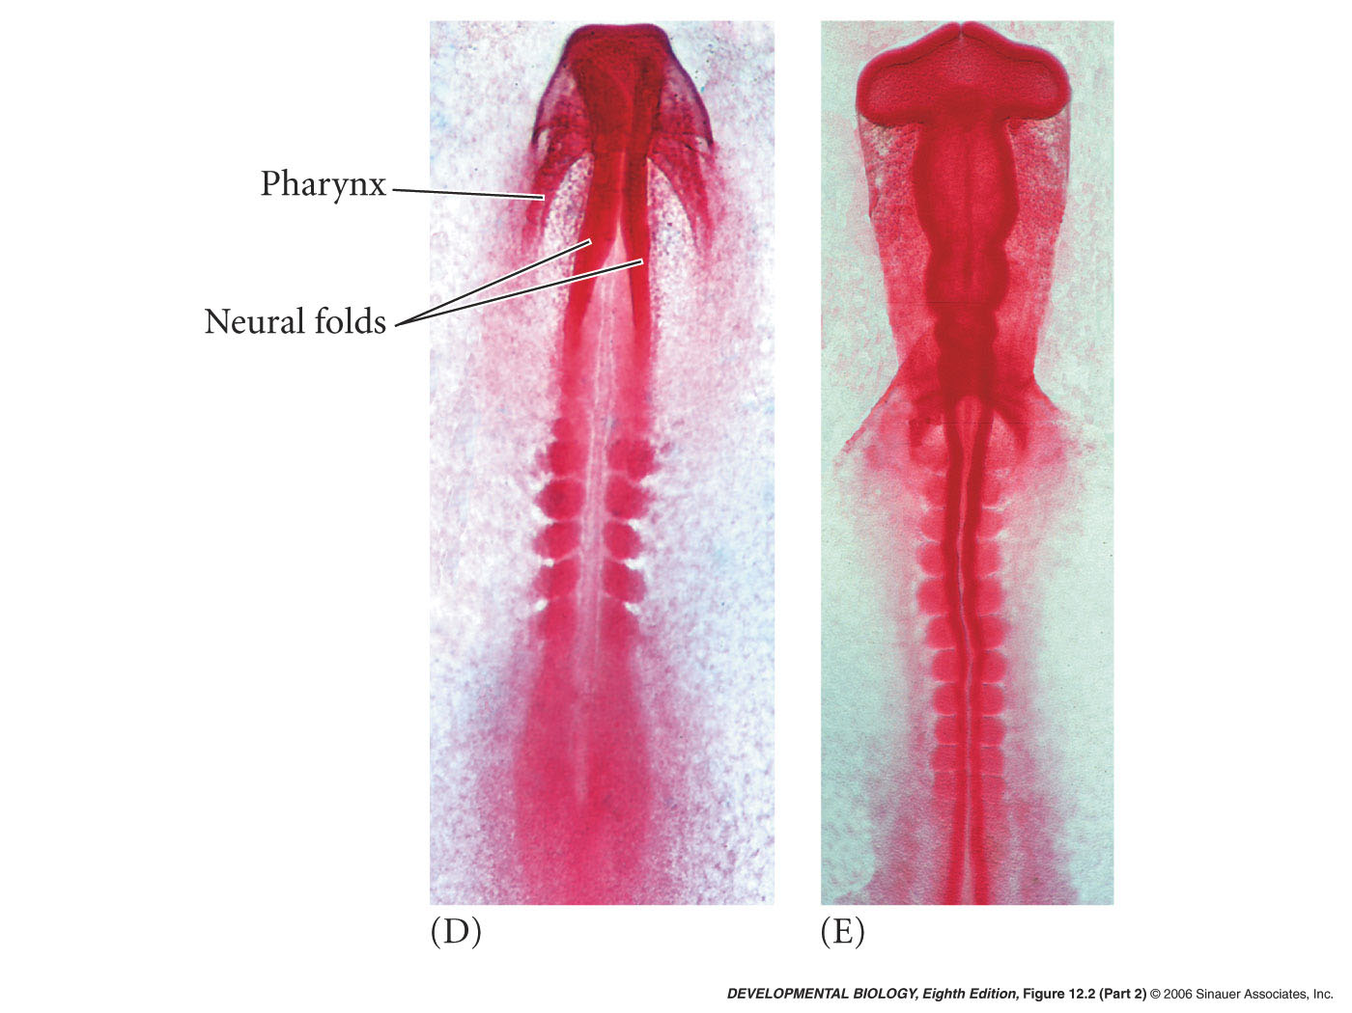
12.2 Neurulation in a chick embryo (dorsal view) (Part 2)
Notes:
devbio8e-fig-12-02-2.jpg

Slide 8
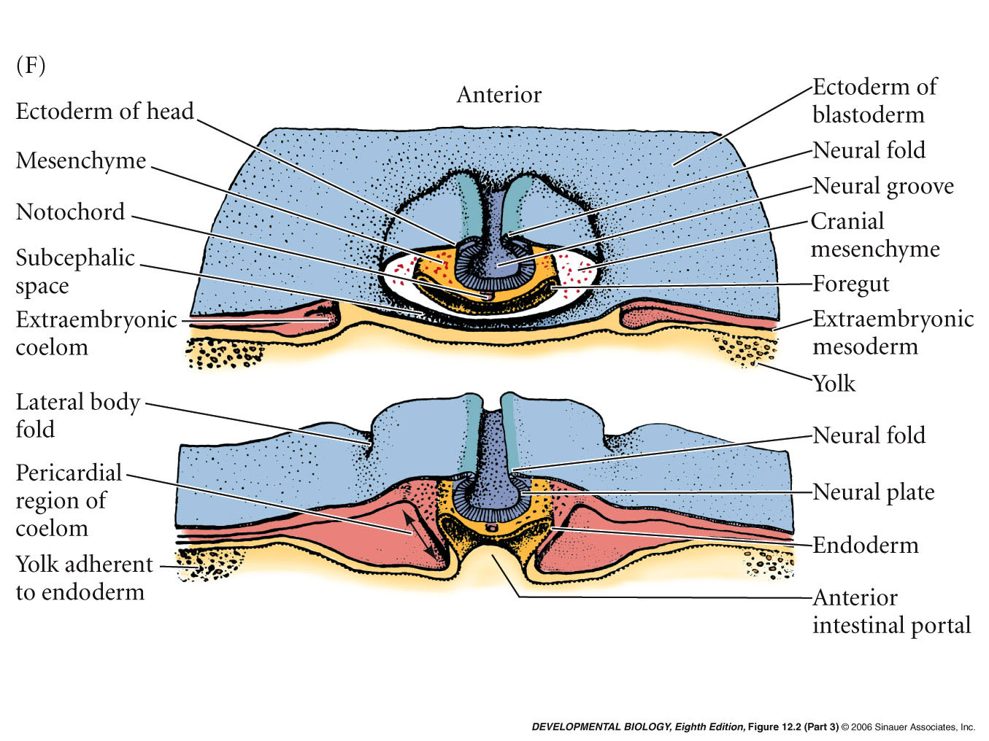
12.2 Neurulation in a chick embryo (dorsal view) (Part 3)
Notes:
devbio8e-fig-12-02-3.jpg

Slide 9
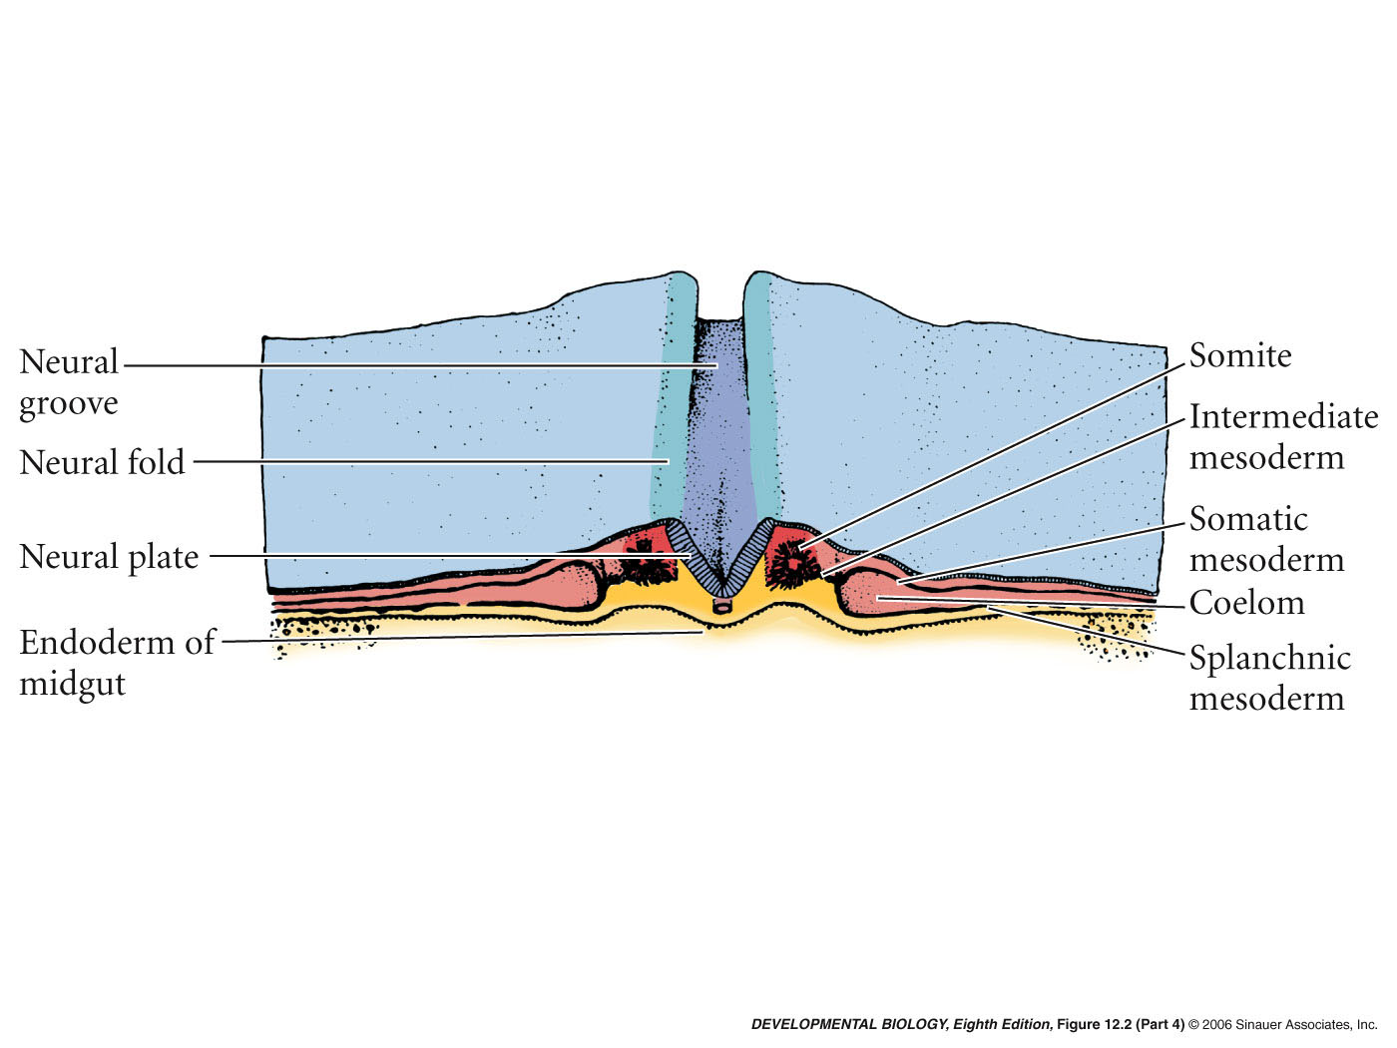
12.2 Neurulation in a chick embryo (dorsal view) (Part 4)
Notes:
devbio8e-fig-12-02-4.jpg

Slide 10
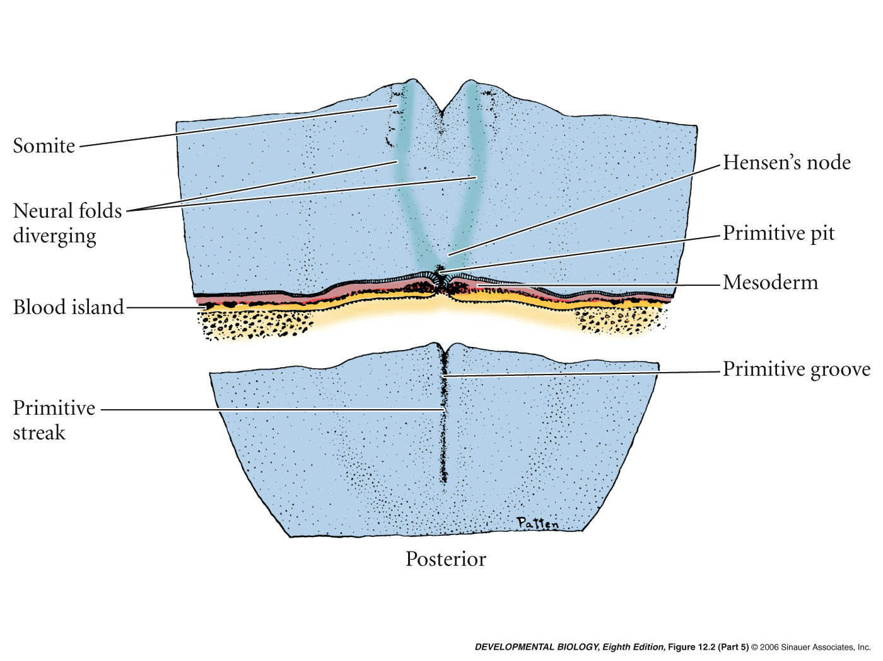
12.2 Neurulation in a chick embryo (dorsal view) (Part 5)
Notes:
devbio8e-fig-12-02-5.jpg

Slide 11
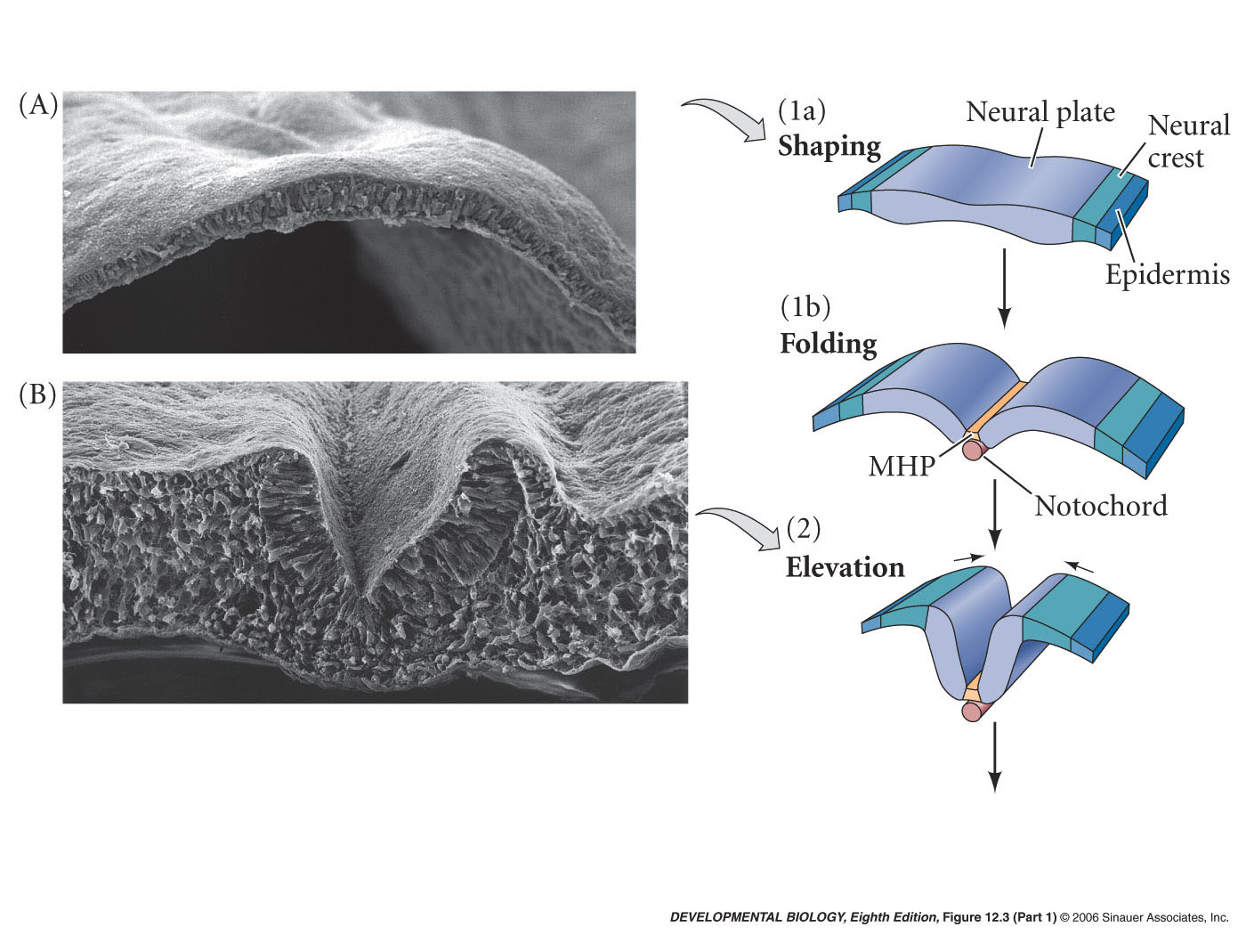
12.3 Primary neurulation: neural tube formation in the chick embryo (Part 1)
Notes:
devbio8e-fig-12-03-1.jpg

Slide 12
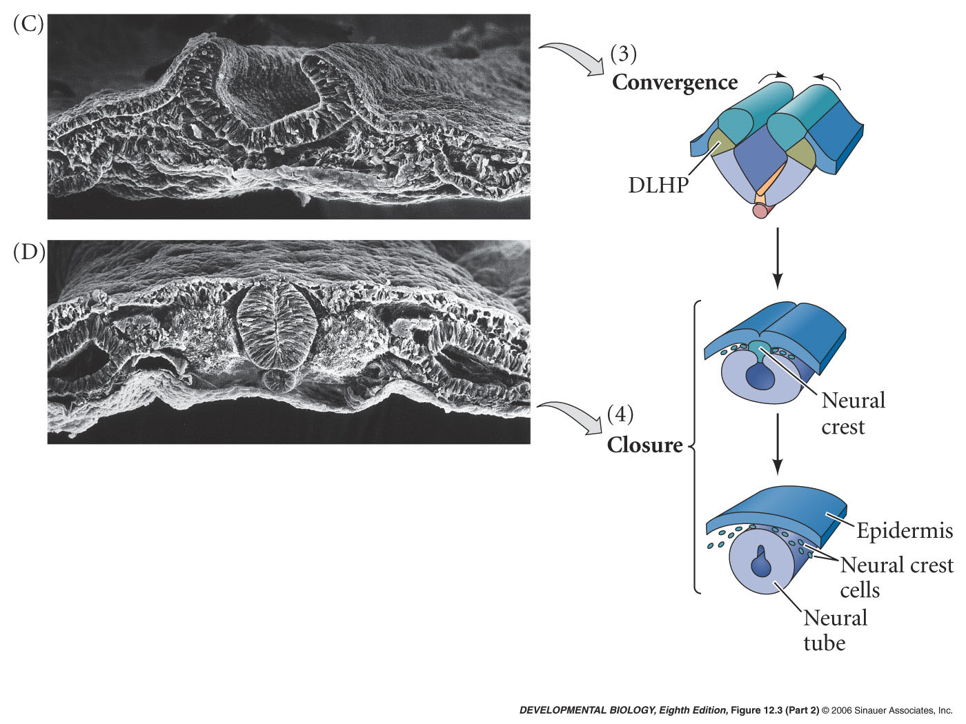
12.3 Primary neurulation: neural tube formation in the chick embryo (Part 2)
Notes:
devbio8e-fig-12-03-2.jpg

Slide 13
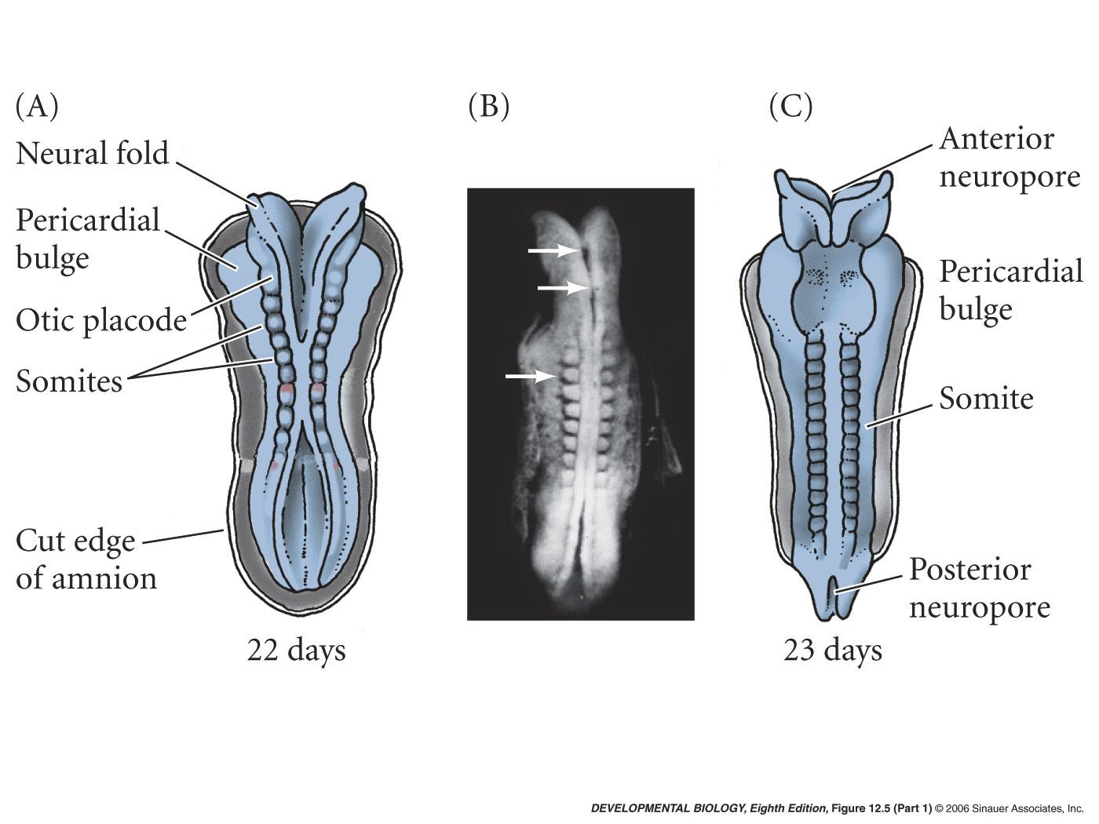
12.5 Neurulation in the human embryo (Part 1)
Notes:
devbio8e-fig-12-05-1.jpg

Slide 14
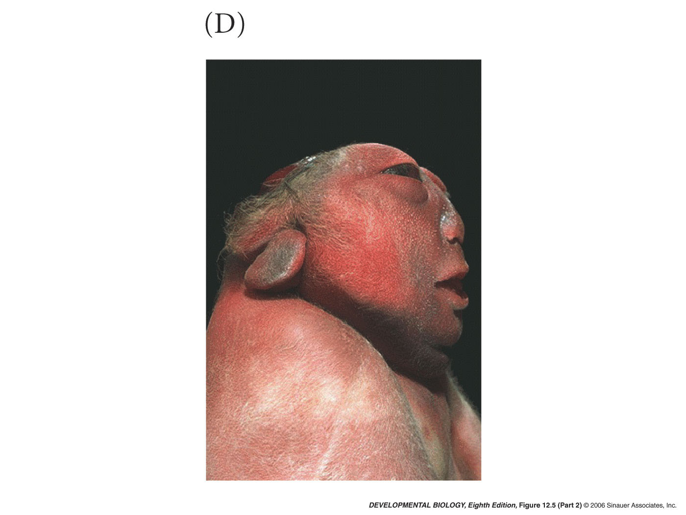
12.5 Neurulation in the human embryo (Part 2)
Notes:
devbio8e-fig-12-05-2.jpg

Slide 15
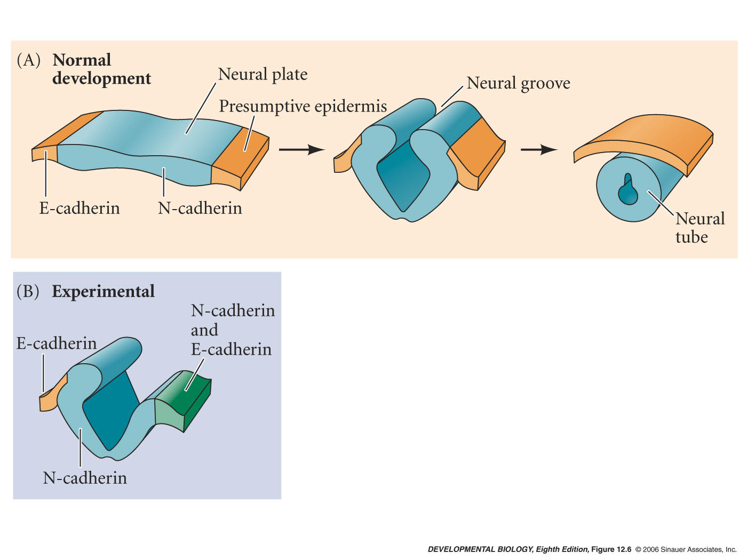
12.6 Expression of N- and E-cadherin adhesion proteins during neurulation in Xenopus
Notes:
devbio8e-fig-12-06-0.jpg

Slide 16
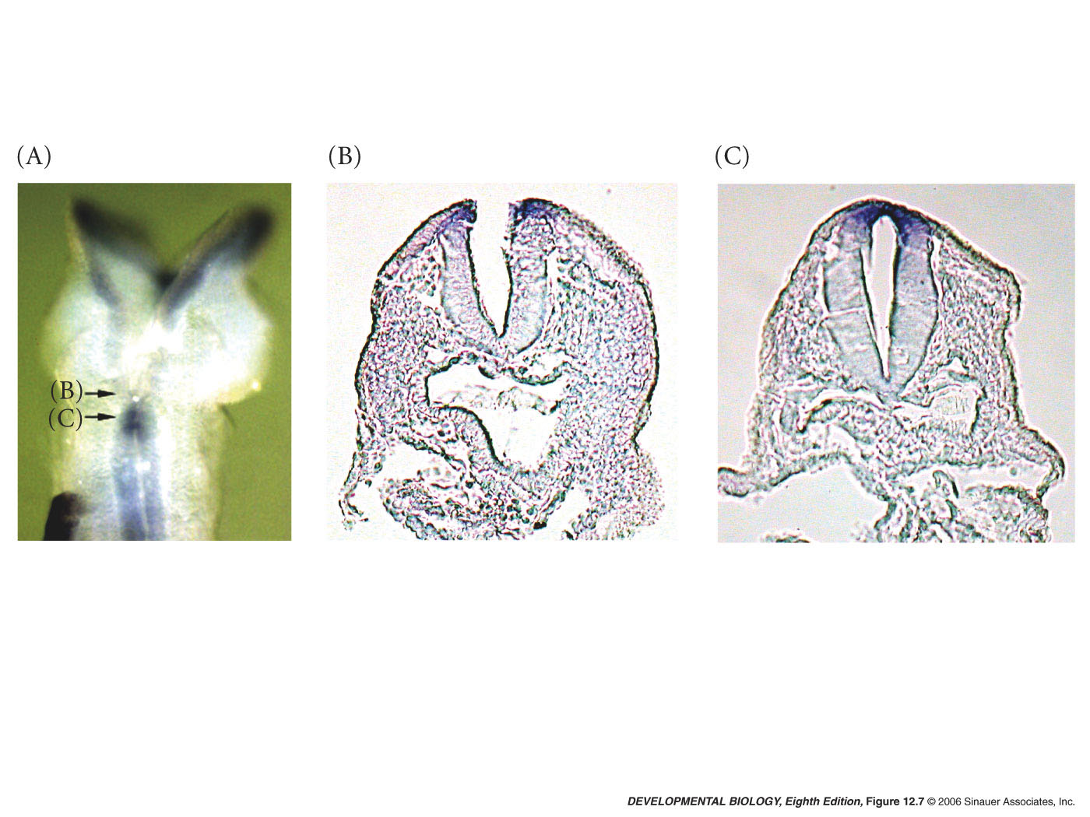
12.7 Folate-binding protein in the neural folds as neural tube closure occurs
Notes:
devbio8e-fig-12-07-0.jpg

Slide 17
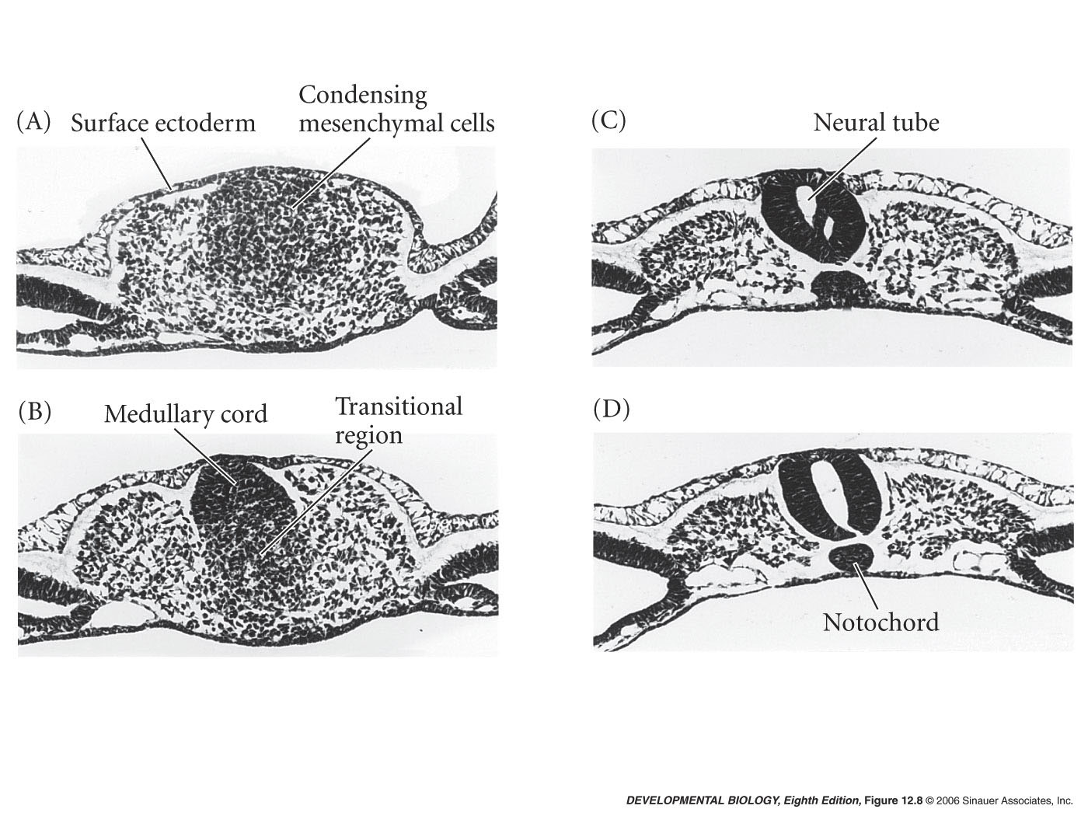
12.8 Secondary neurulation in the caudal region of a 25-somite chick embryo
Notes:
devbio8e-fig-12-08-0.jpg

Slide 18
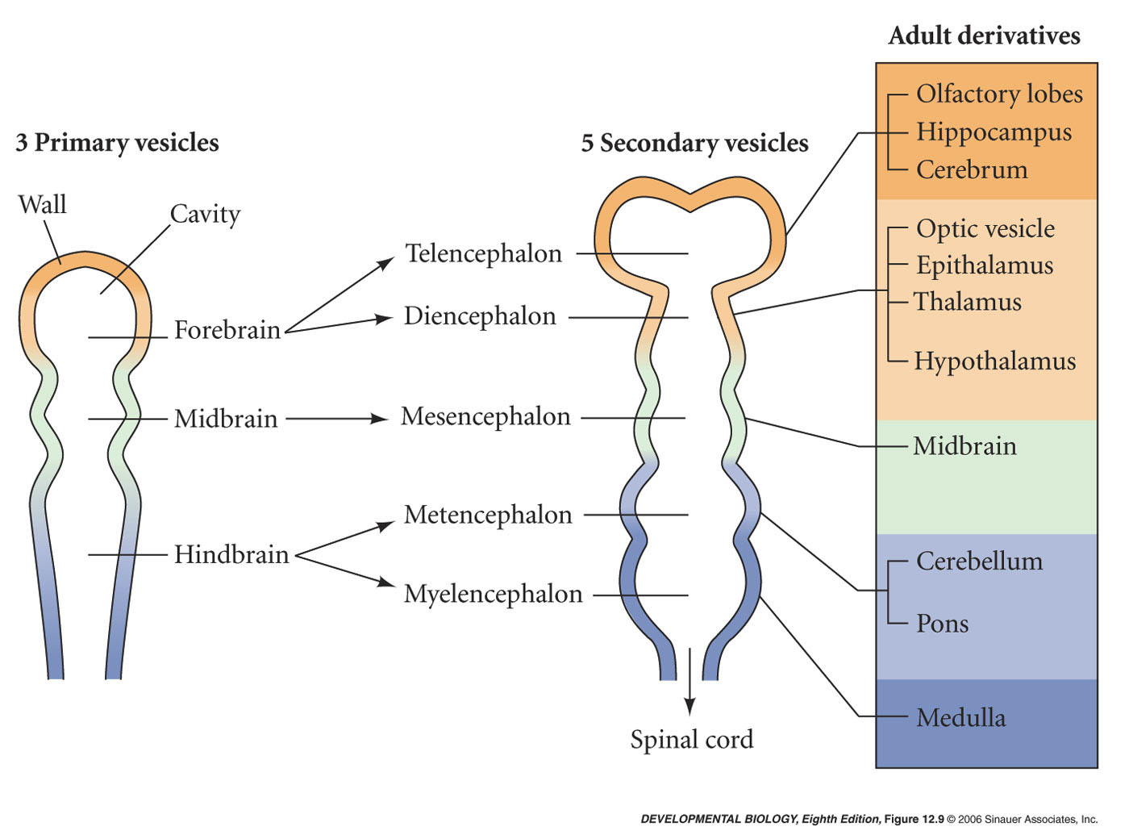
12.9 Early human brain development
Notes:
devbio8e-fig-12-09-0.jpg

Slide 19
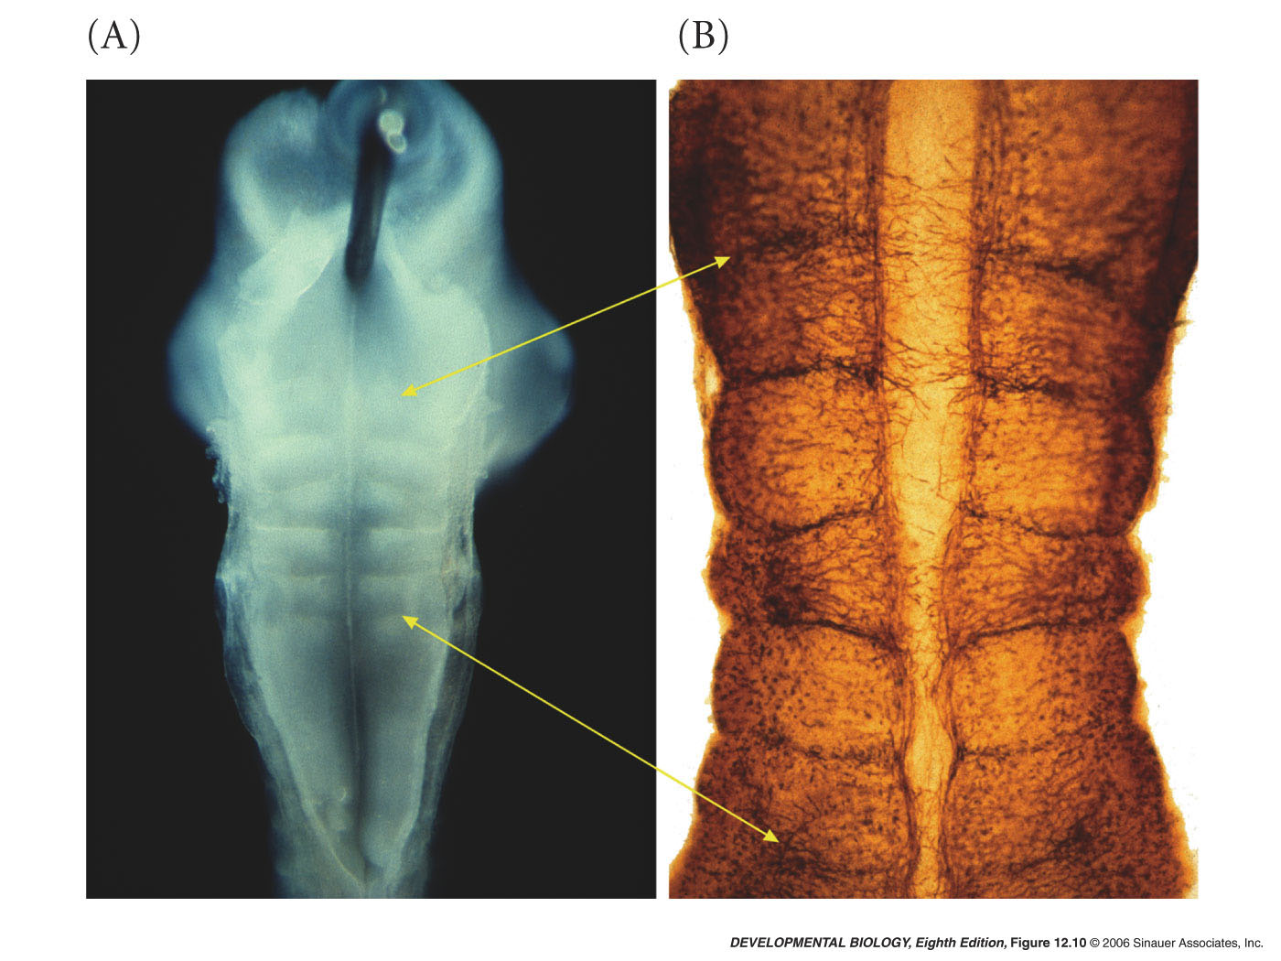
12.10 Rhombomeres of the chick hindbrain
Notes:
devbio8e-fig-12-10-0.jpg

Slide 20
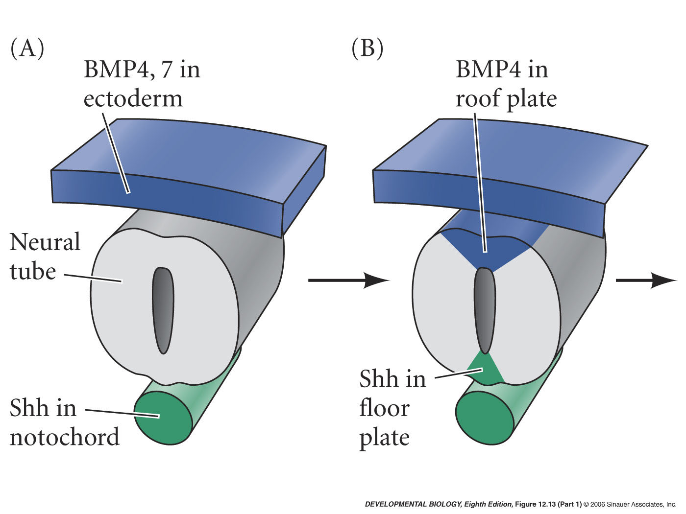
12.13 Dorsal-ventral specification of the neural tube (Part 1)
Notes:
devbio8e-fig-12-13-1.jpg

Slide 21
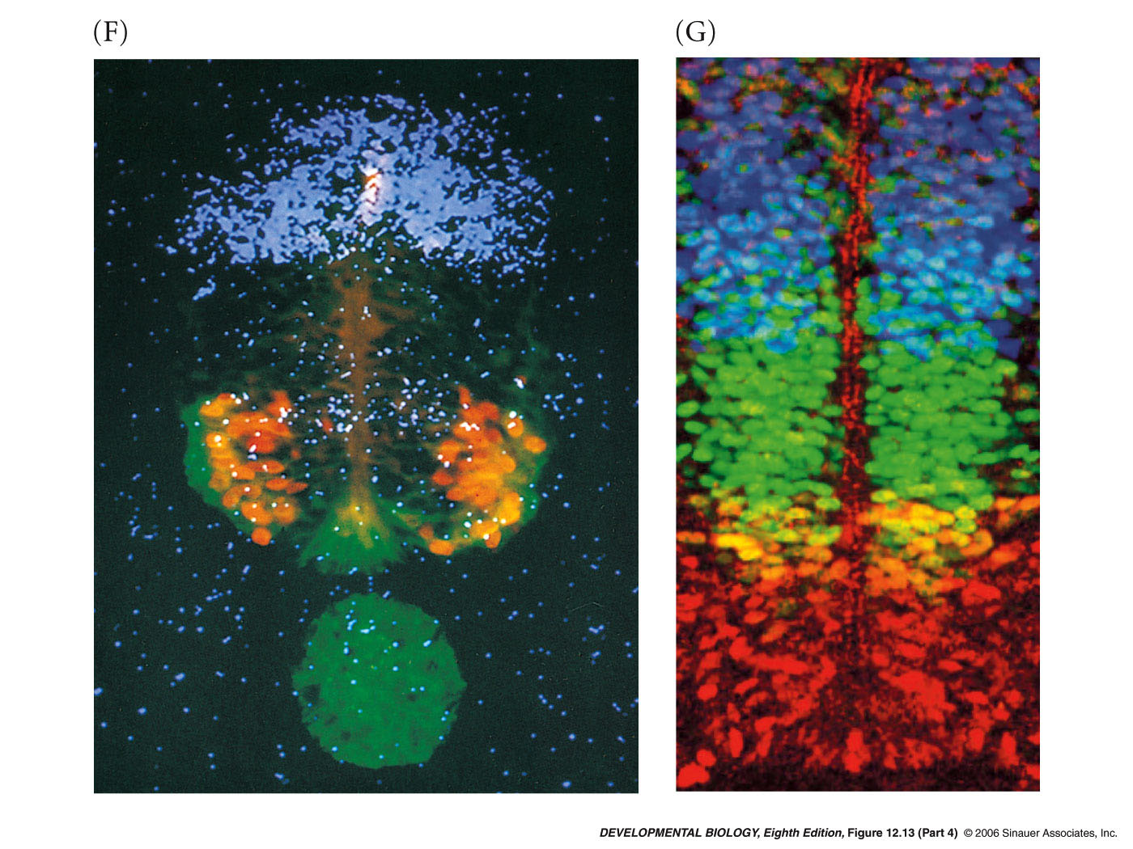
12.13 Dorsal-ventral specification of the neural tube (Part 4)
Notes:
devbio8e-fig-12-13-4.jpg

Slide 22
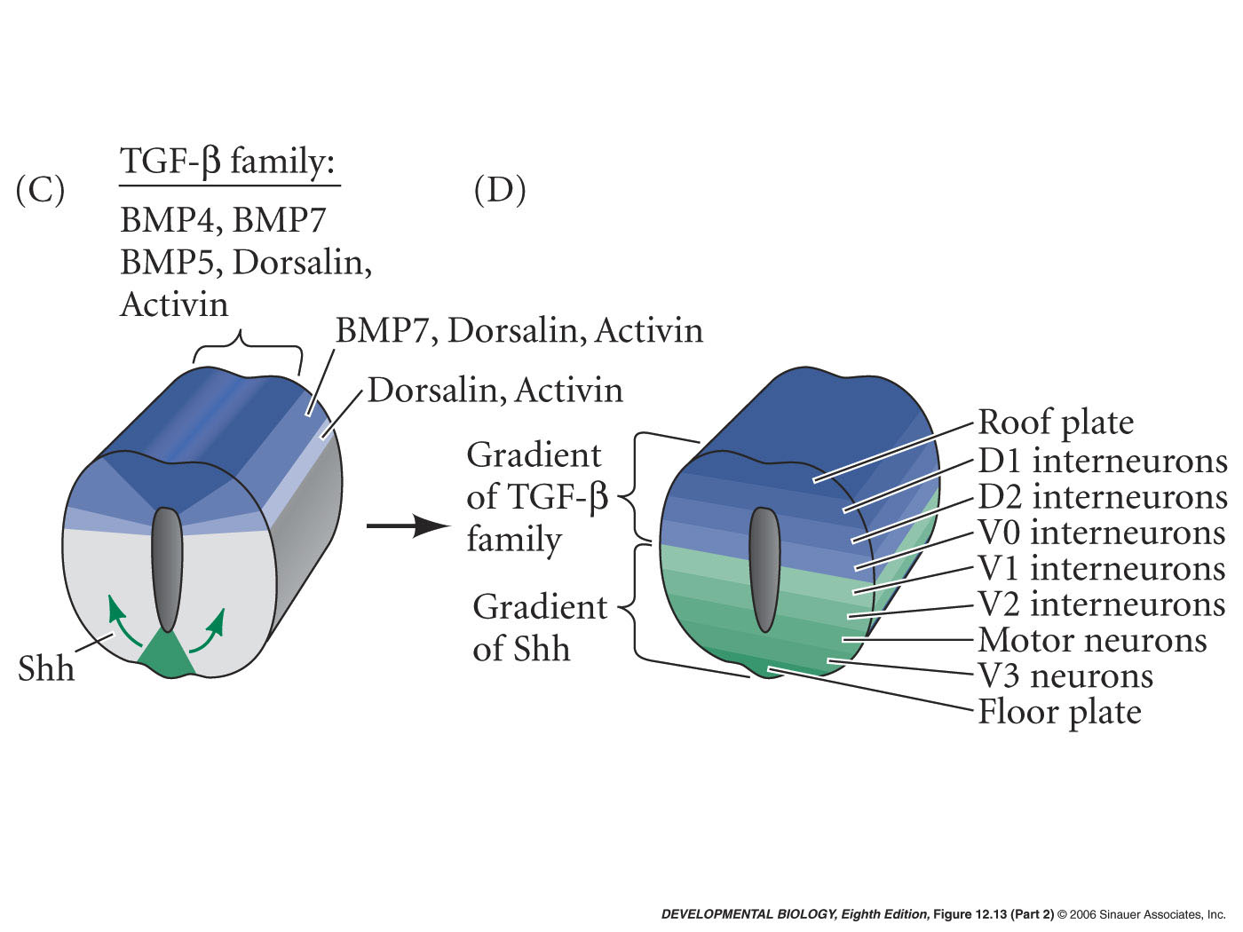
12.13 Dorsal-ventral specification of the neural tube (Part 2)
Notes:
devbio8e-fig-12-13-2.jpg

Slide 23
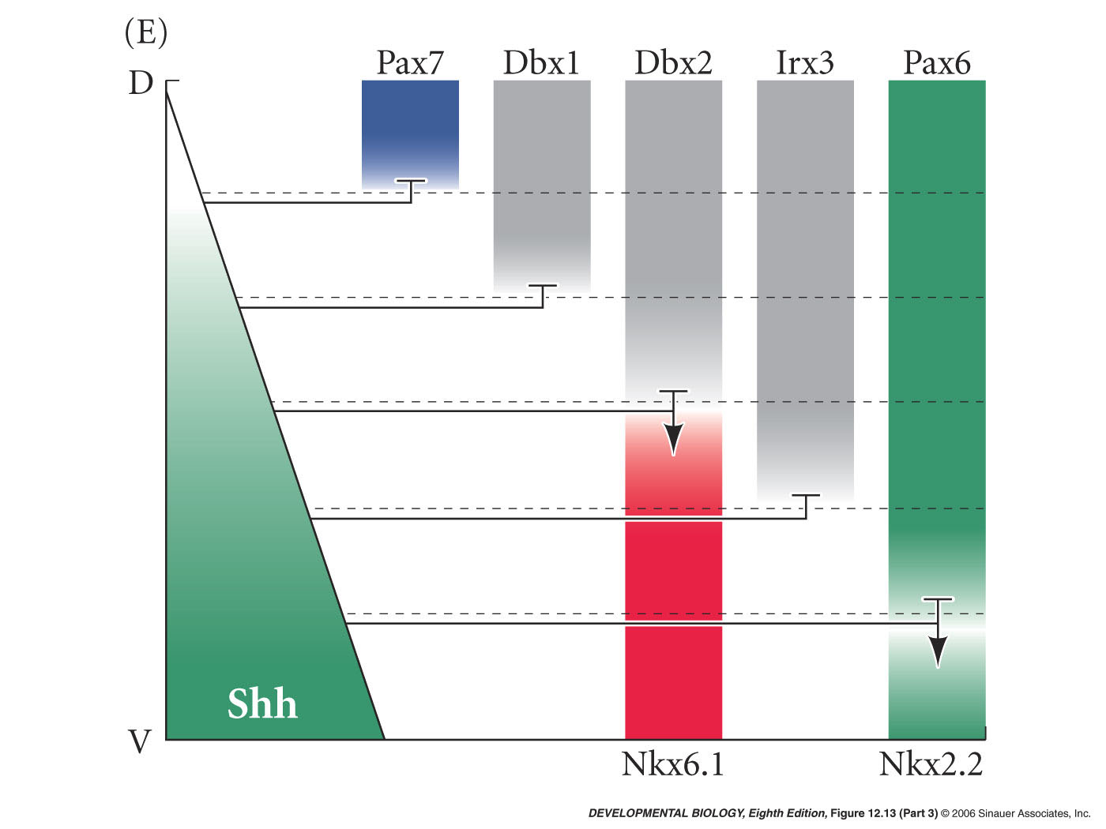
12.13 Dorsal-ventral specification of the neural tube (Part 3)
Notes:
devbio8e-fig-12-13-3.jpg

Slide 24
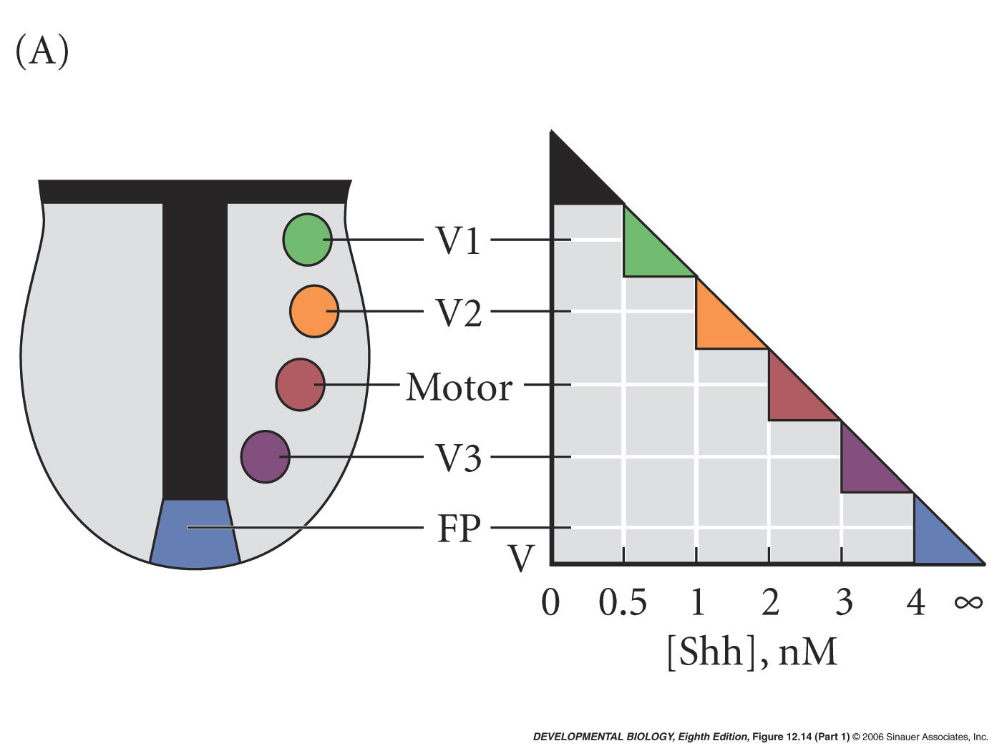
12.14 Cascade of inductions initiated by the notochord in the ventral neural tube (Part 1)
Notes:
devbio8e-fig-12-14-1.jpg

Slide 25
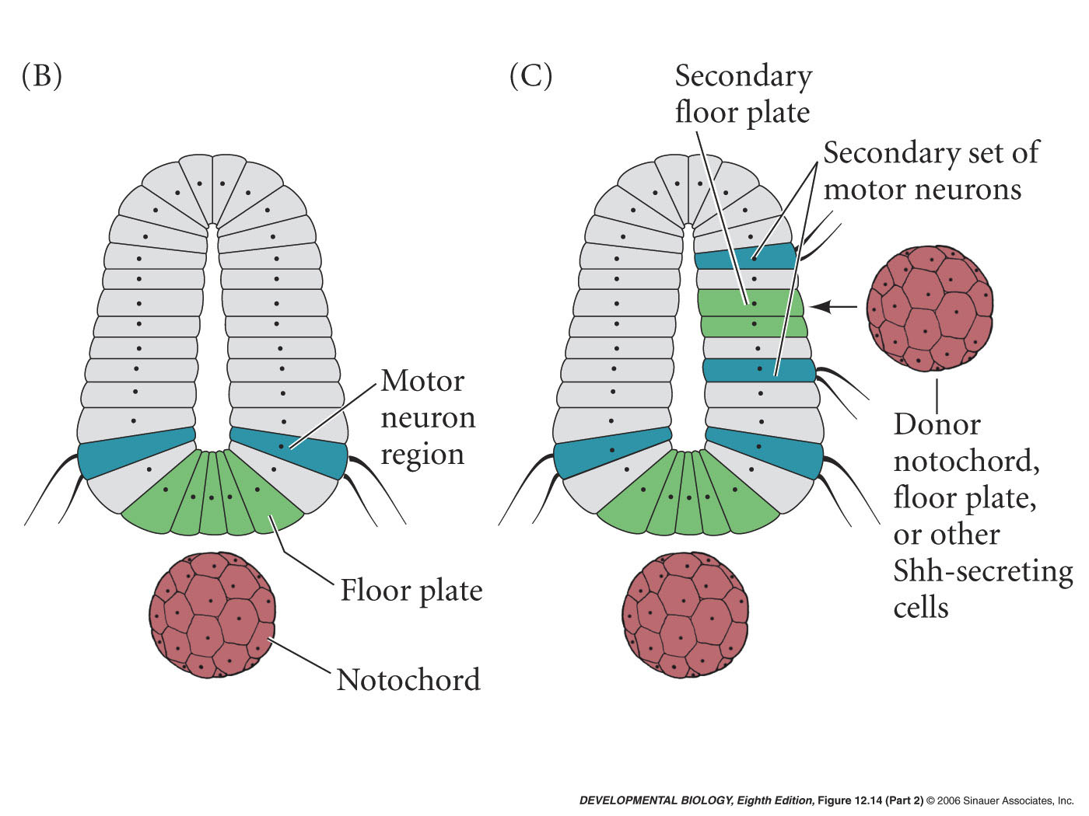
12.14 Cascade of inductions initiated by the notochord in the ventral neural tube (Part 2)
Notes:
devbio8e-fig-12-14-2.jpg

Slide 26
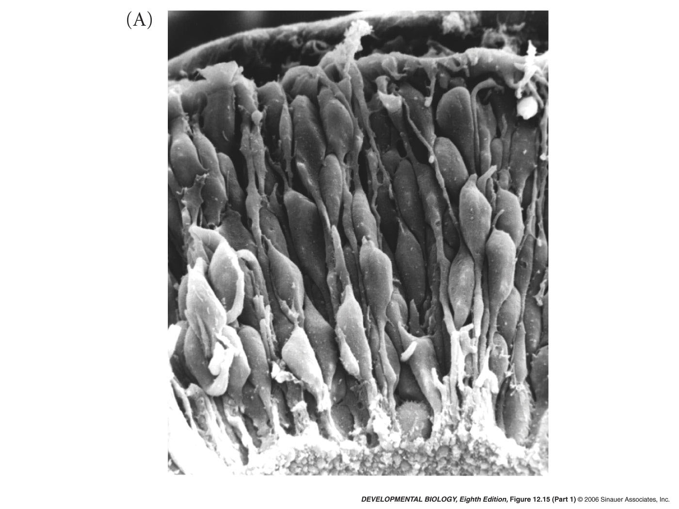
12.15 Neural stem cells in the germinal epithelium (Part 1)
Notes:
devbio8e-fig-12-15-1.jpg

Slide 27
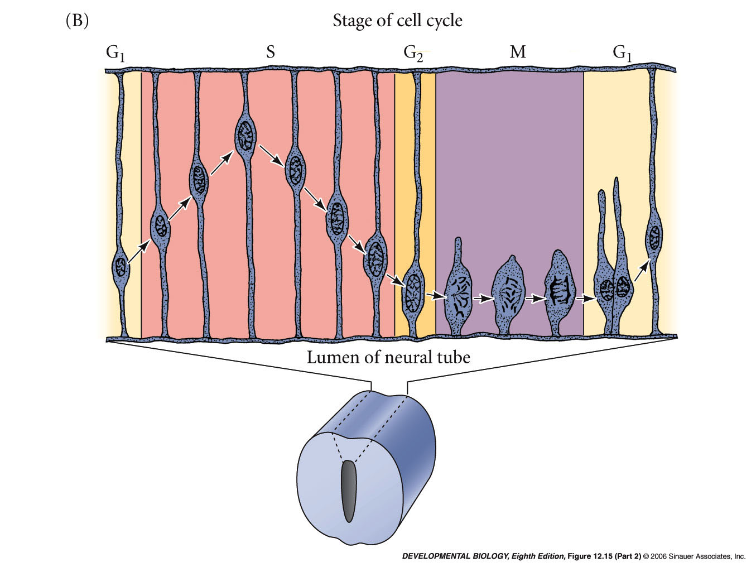
12.15 Neural stem cells in the germinal epithelium (Part 2)
Notes:
devbio8e-fig-12-15-2.jpg

Slide 28
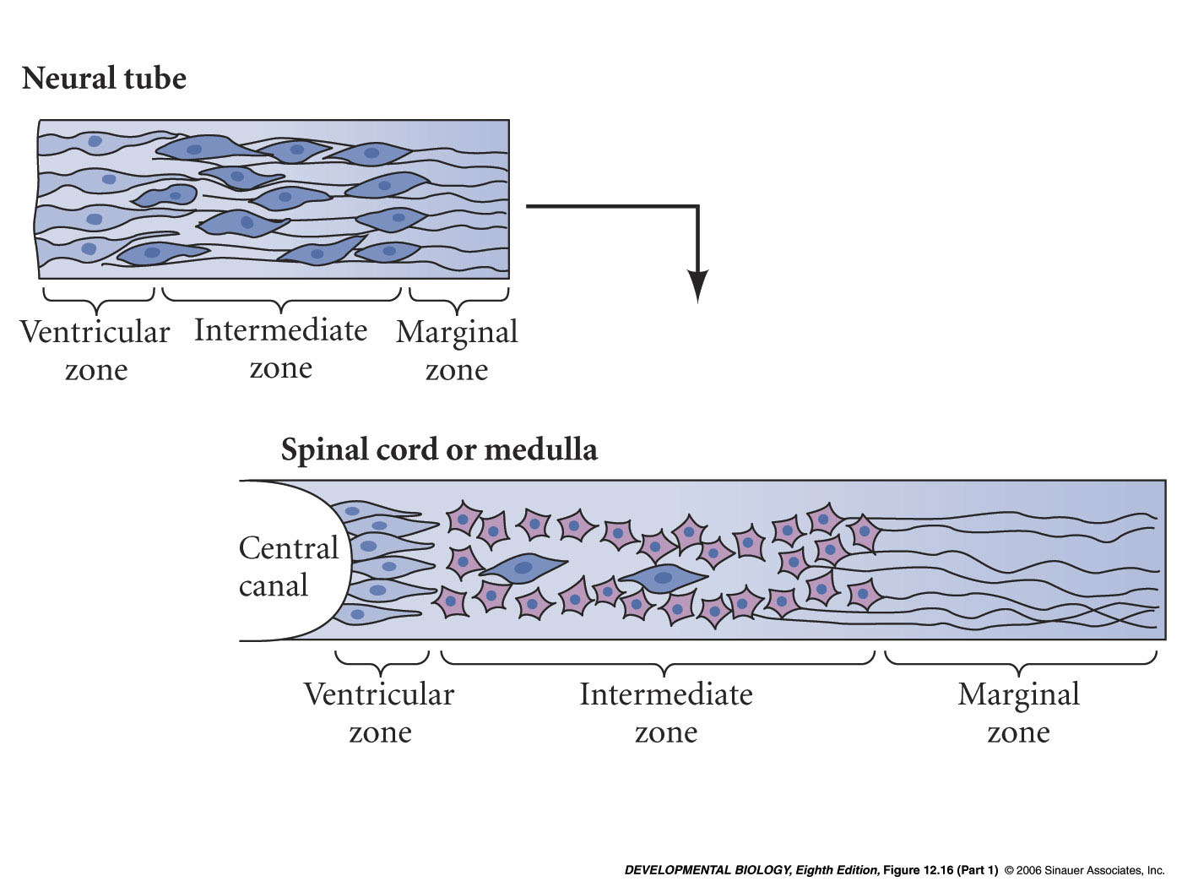
12.16 Differentiation of the walls of the neural tube (Part 1)
Notes:
devbio8e-fig-12-16-1.jpg

Slide 29
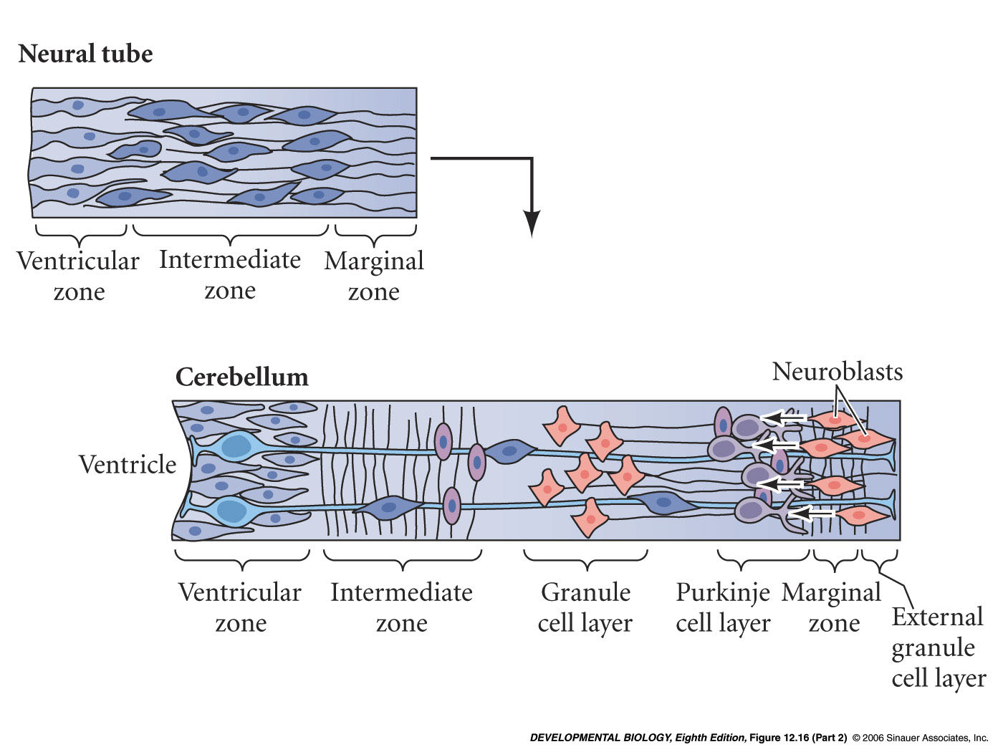
12.16 Differentiation of the walls of the neural tube (Part 2)
Notes:
devbio8e-fig-12-16-2.jpg

Slide 30
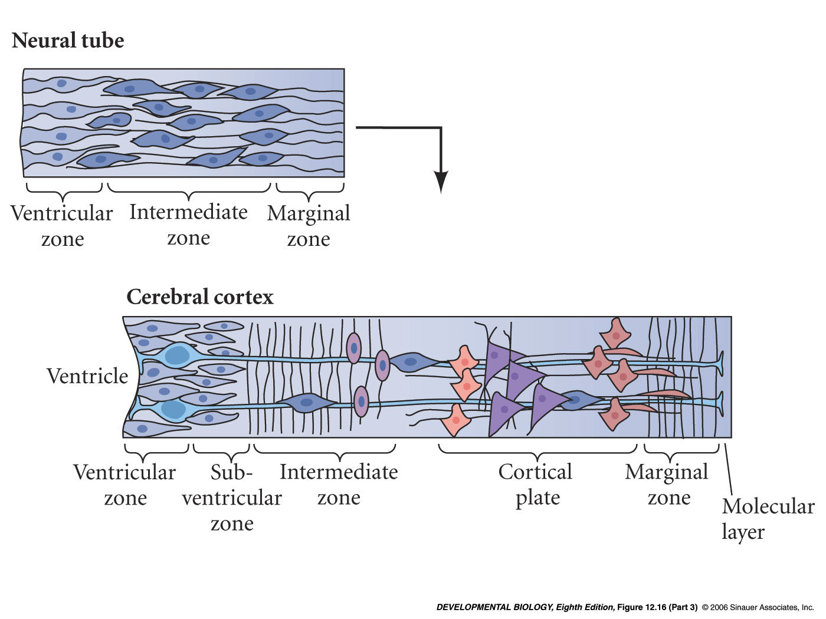
12.16 Differentiation of the walls of the neural tube (Part 3)
Notes:
devbio8e-fig-12-16-3.jpg

Slide 31
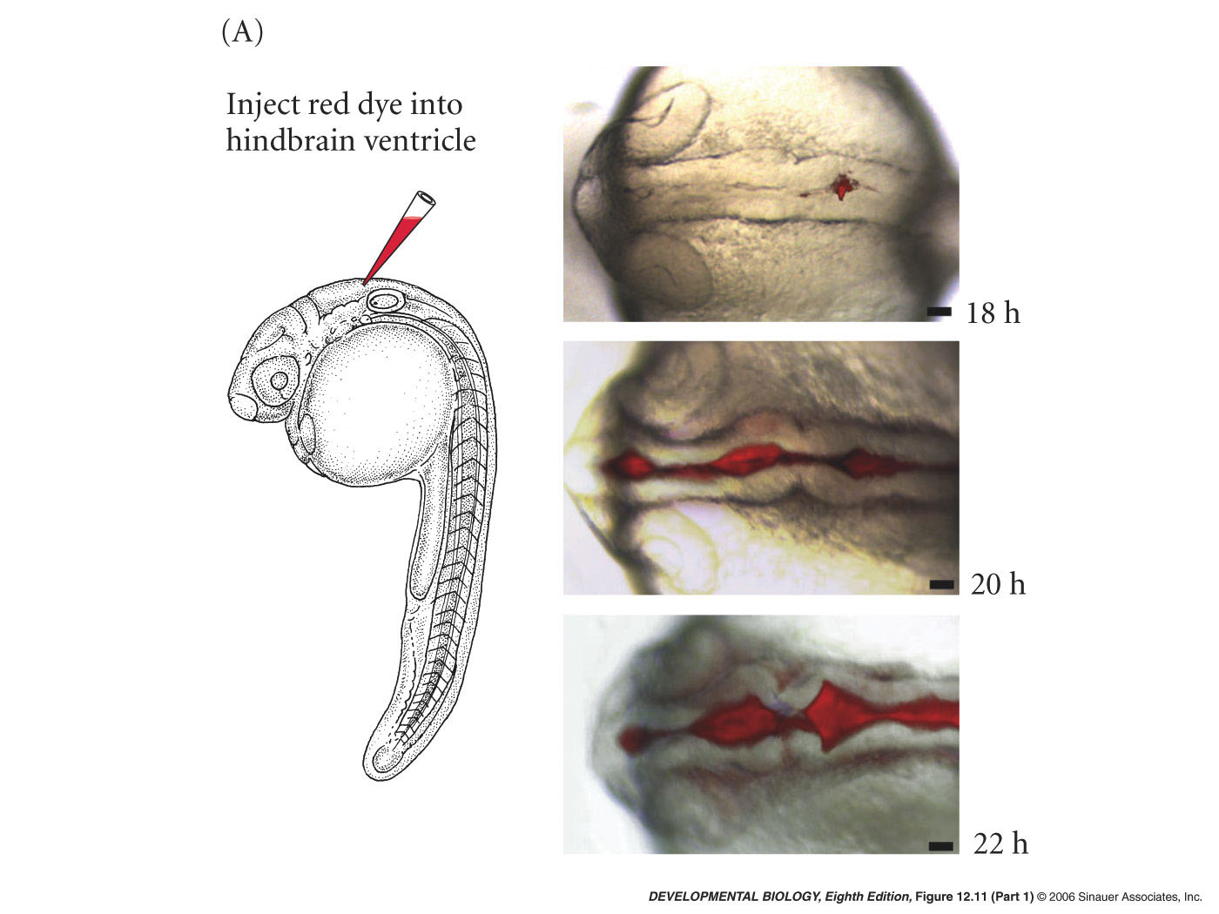
12.11 Brain ventricle formation in zebrafish (Part 1)
Notes:
devbio8e-fig-12-11-1.jpg

Slide 32
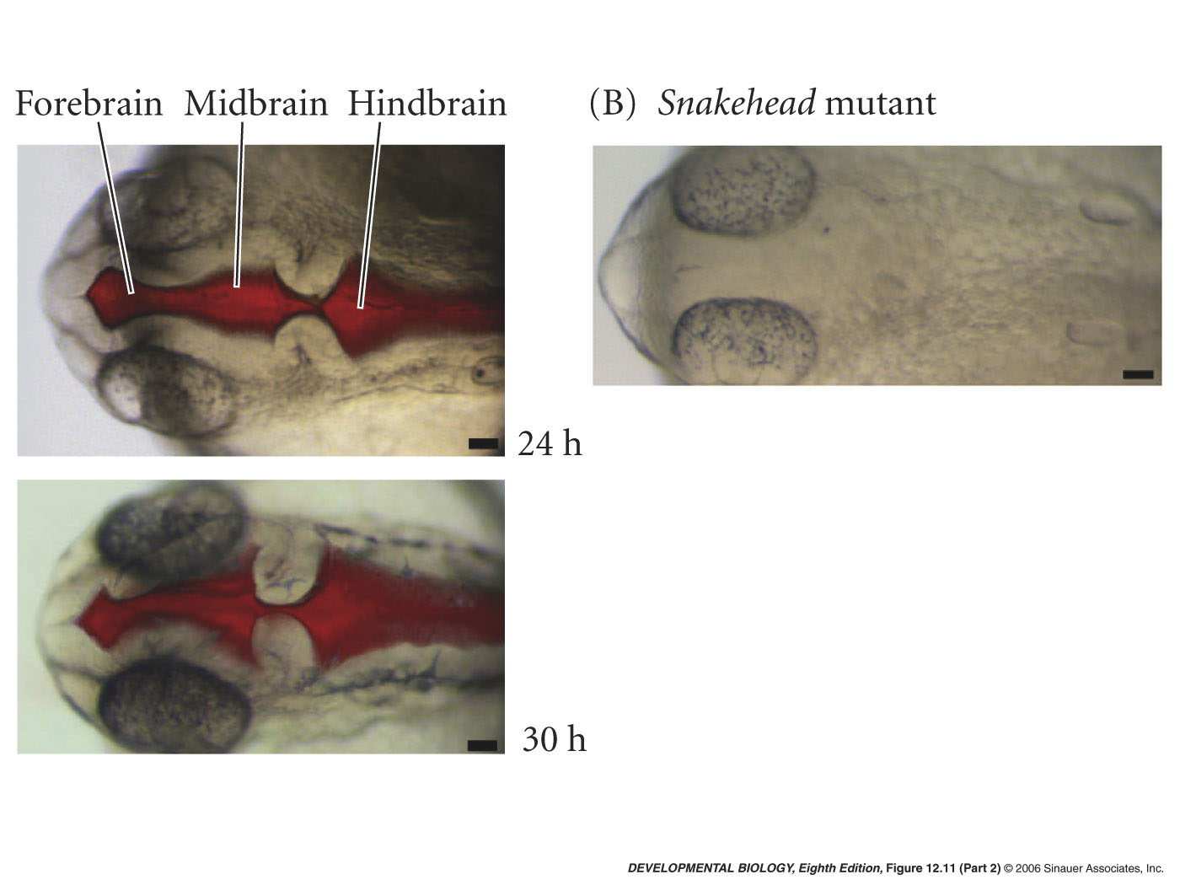
12.11 Brain ventricle formation in zebrafish (Part 2)
Notes:
devbio8e-fig-12-11-2.jpg

Slide 33
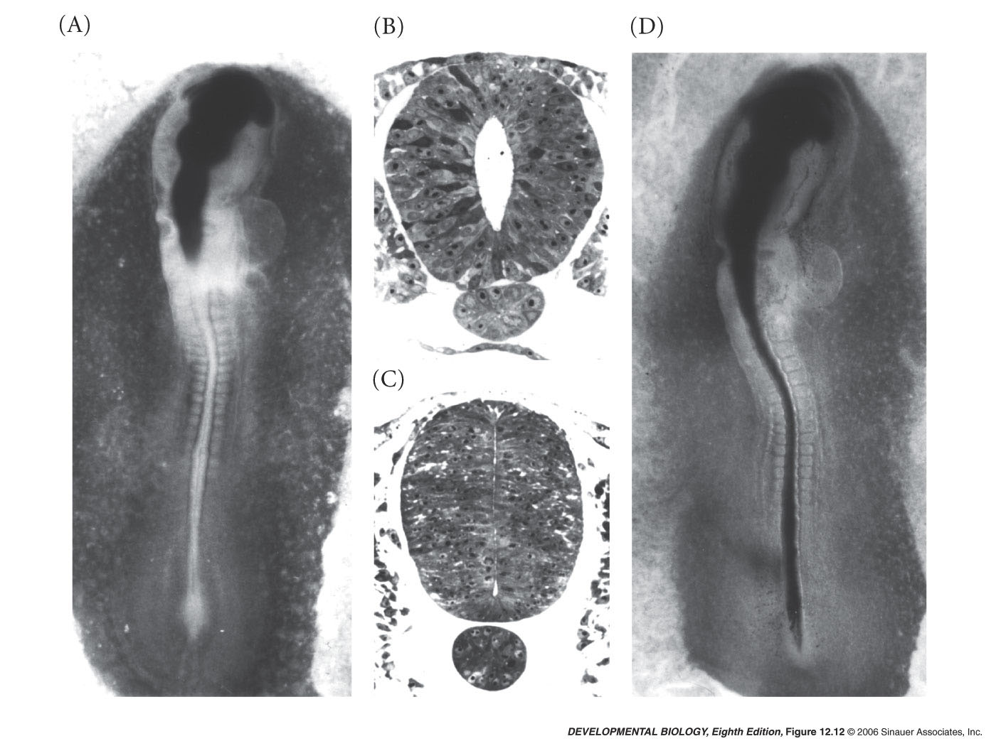
12.12 Occlusion of the neural tube allows expansion of the future brain region
Notes:
devbio8e-fig-12-12-0.jpg

Slide 34
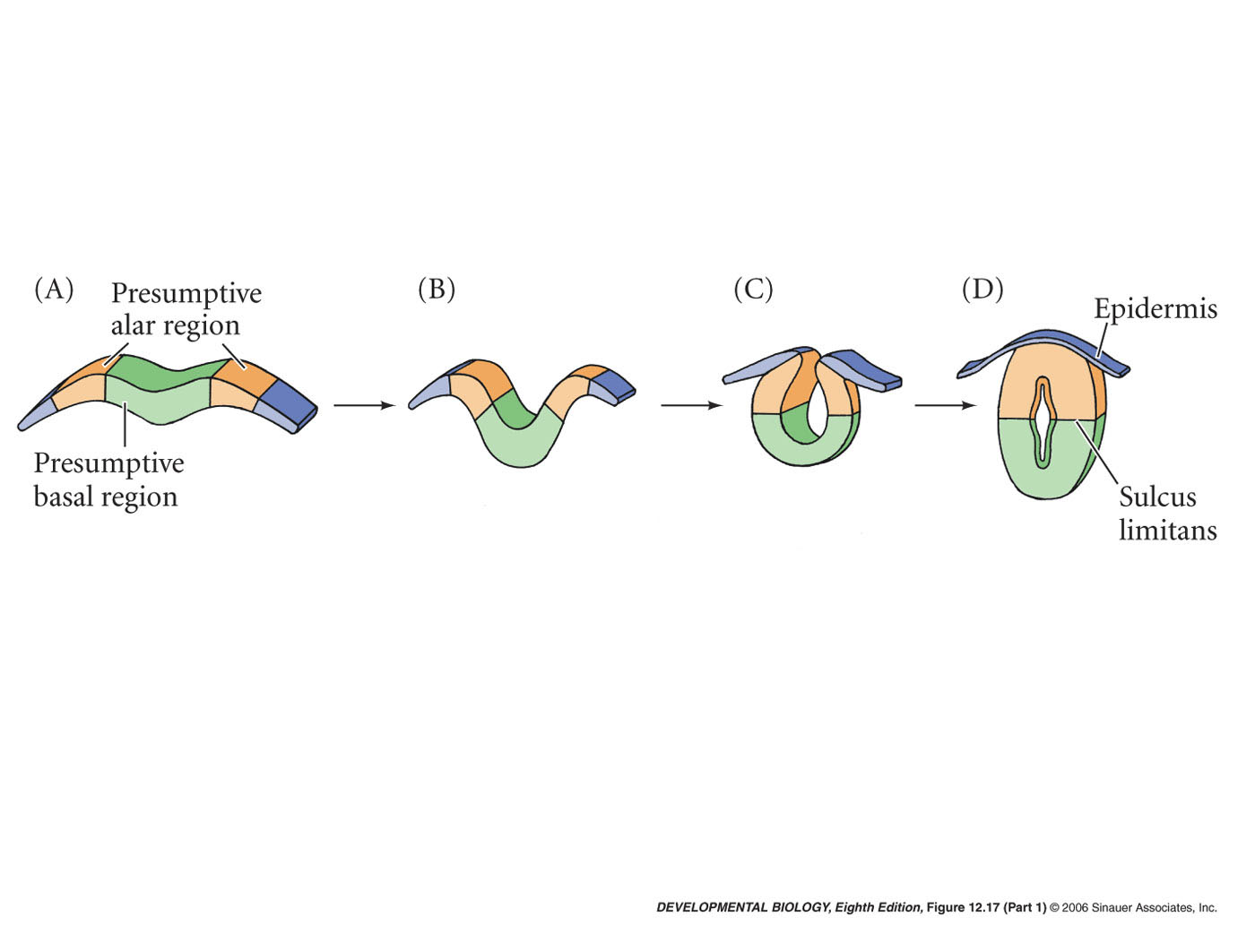
12.17 Development of the human spinal cord (Part 1)
Notes:
devbio8e-fig-12-17-1.jpg

Slide 35
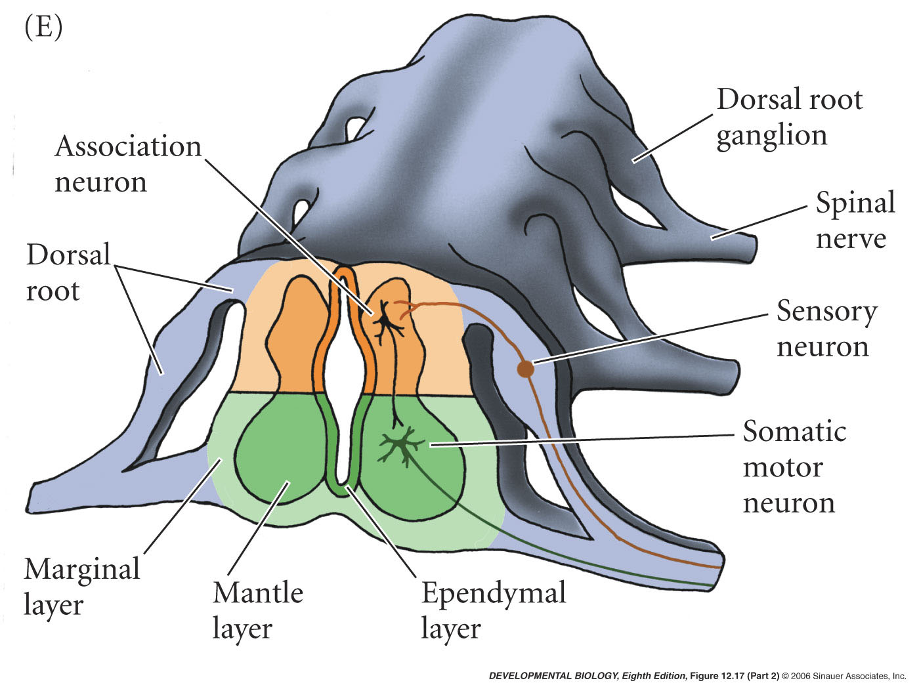
12.17 Development of the human spinal cord (Part 2)
Notes:
devbio8e-fig-12-17-2.jpg

Slide 36
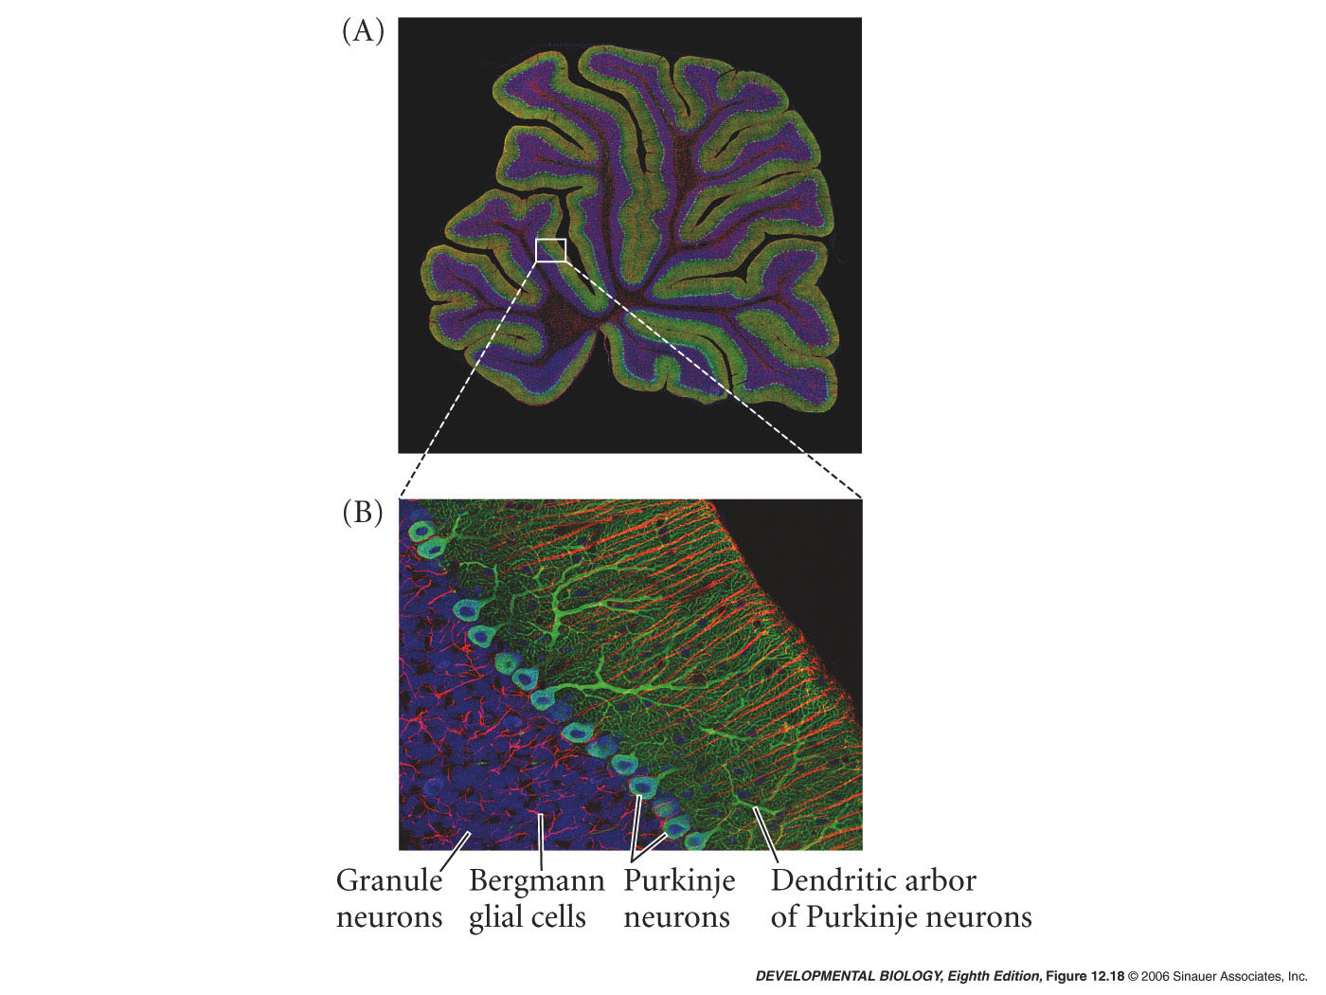
12.18 Cerebellar organization
Notes:
devbio8e-fig-12-18-0.jpg

Slide 37
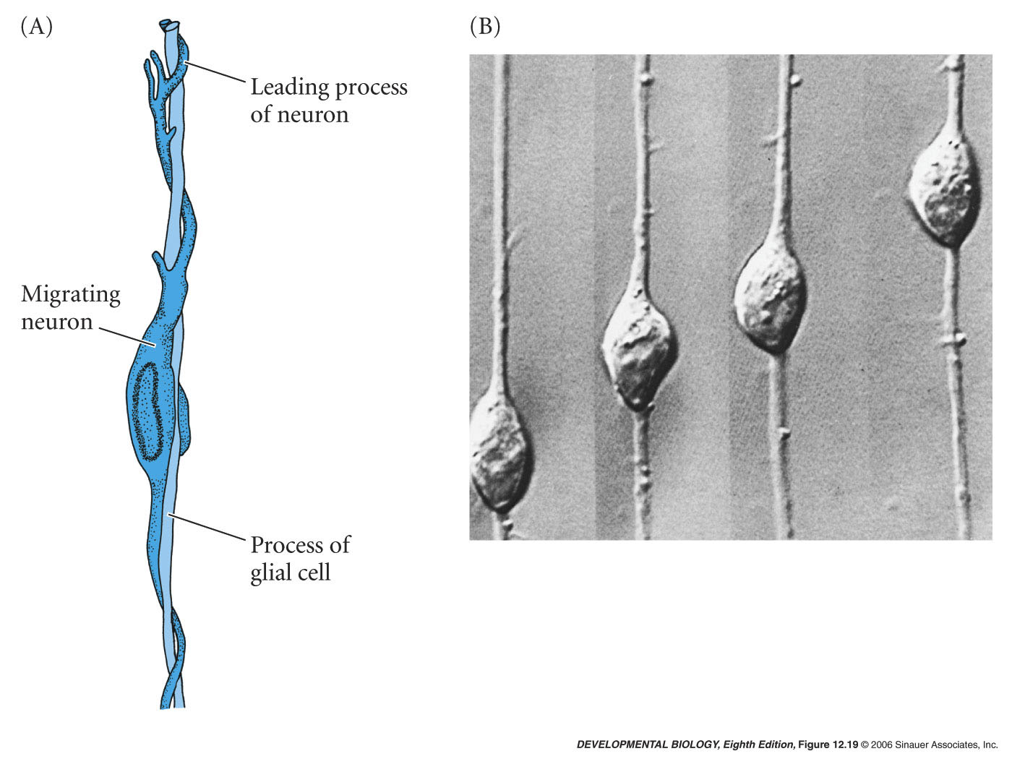
12.19 Neuron-glia interaction
Notes:
devbio8e-fig-12-19-0.jpg

Slide 38
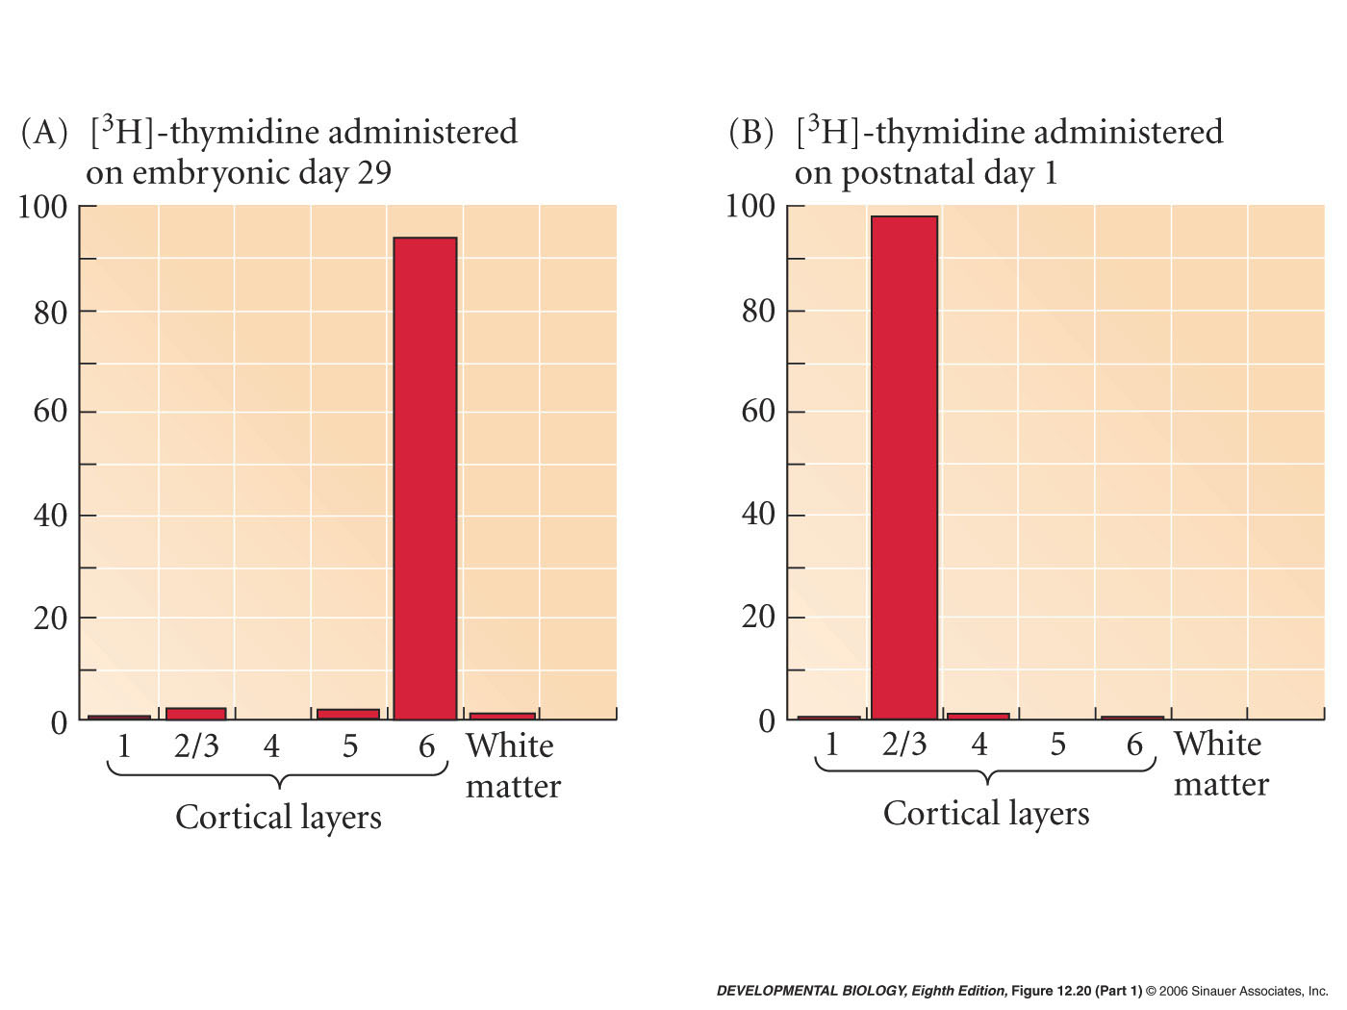
12.20 Determination of cortical laminar identity in the ferret cerebrum (Part 1)
Notes:
devbio8e-fig-12-20-1.jpg

Slide 39
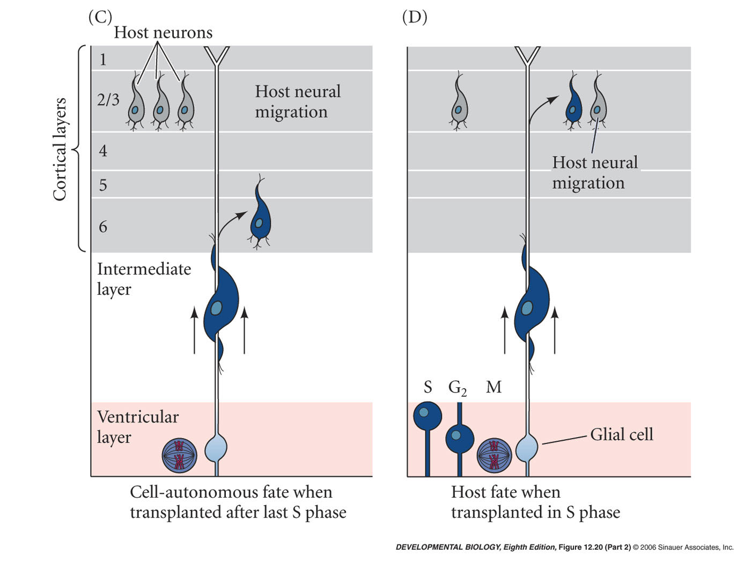
12.20 Determination of cortical laminar identity in the ferret cerebrum (Part 2)
Notes:
devbio8e-fig-12-20-2.jpg

Slide 40
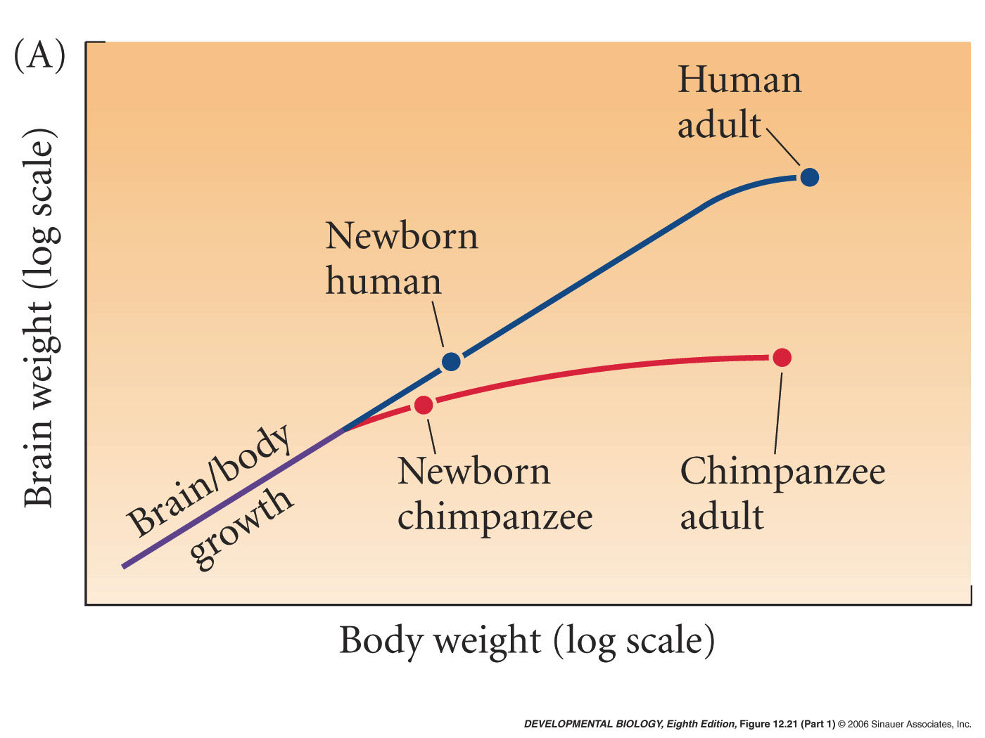
12.21 Retention of fetal neural growth rate in humans (Part 1)
Notes:
devbio8e-fig-12-21-1.jpg

Slide 41
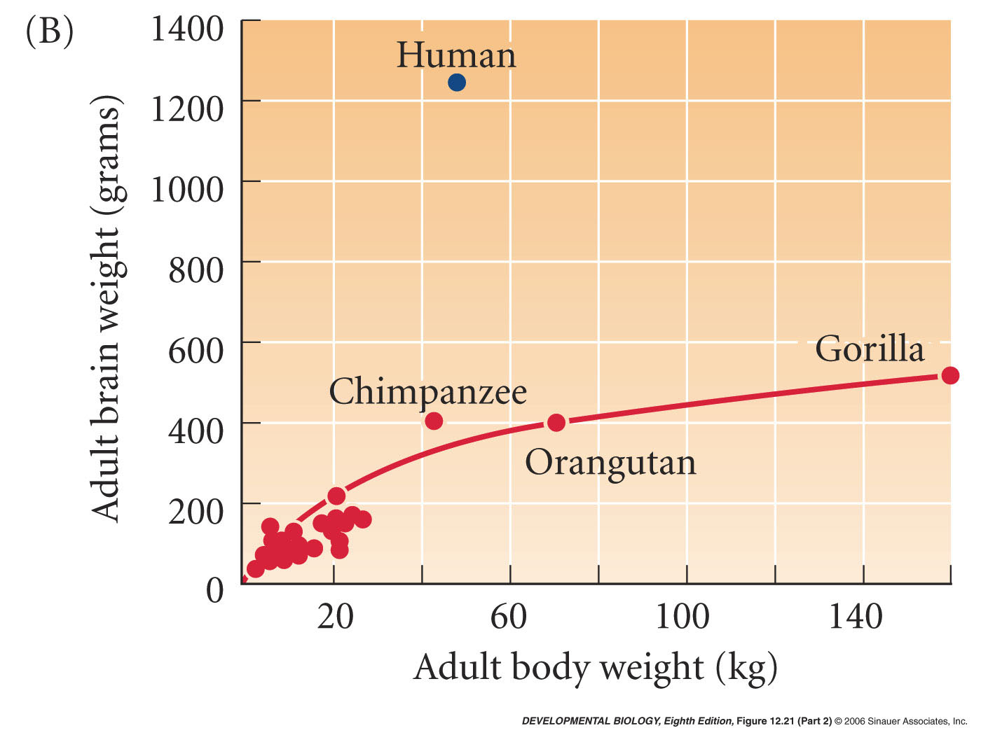
12.21 Retention of fetal neural growth rate in humans (Part 2)
Notes:
devbio8e-fig-12-21-2.jpg

Slide 42
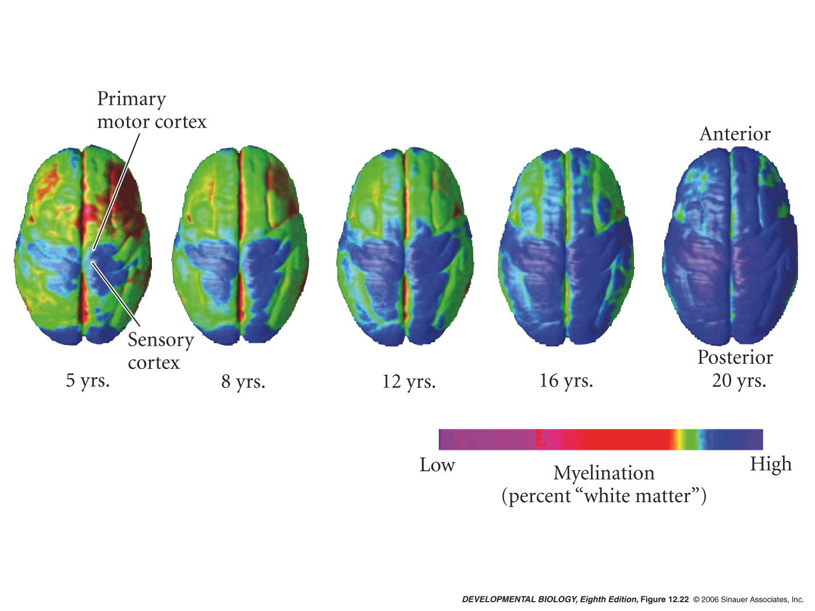
12.22 Human brain showing the progression of myelination over the cortical surface during adolescence
Notes:
devbio8e-fig-12-22-0.jpg

Slide 43
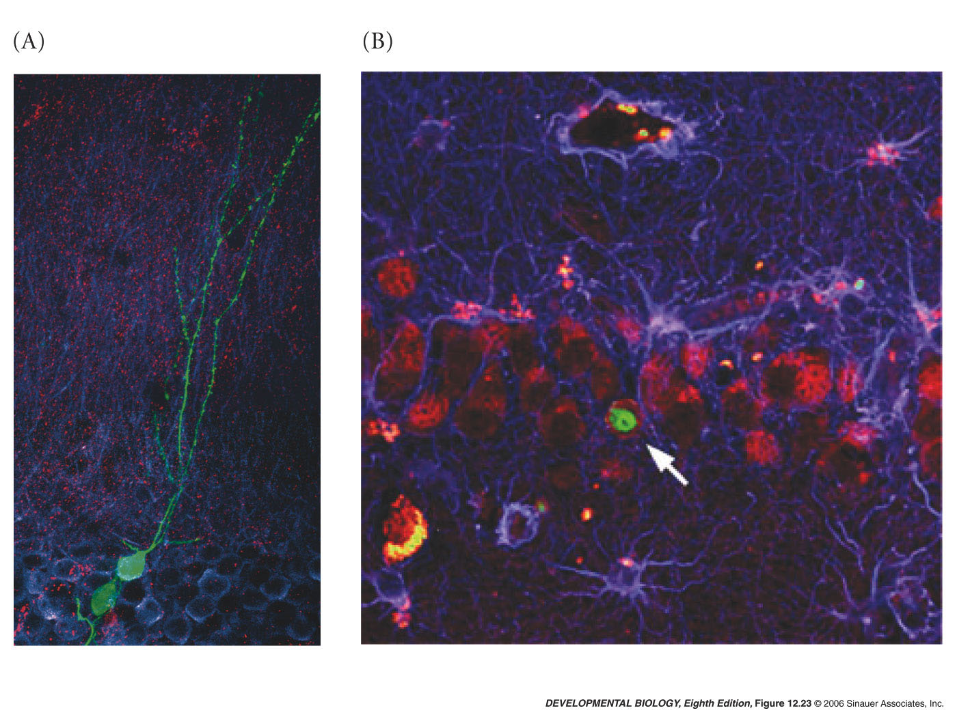
12.23 Evidence of adult neural stem cells
Notes:
devbio8e-fig-12-23-0.jpg

Slide 44
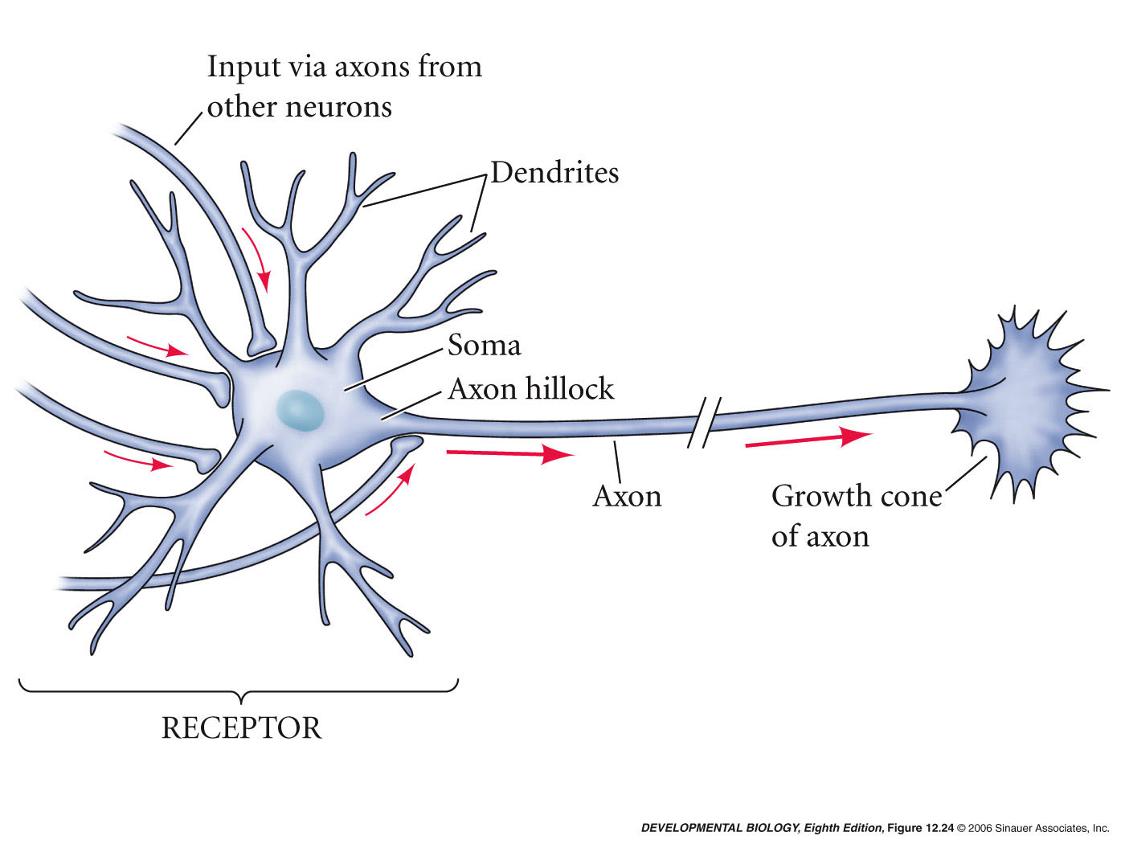
12.24 Diagram of a motor neuron
Notes:
devbio8e-fig-12-24-0.jpg

Slide 45
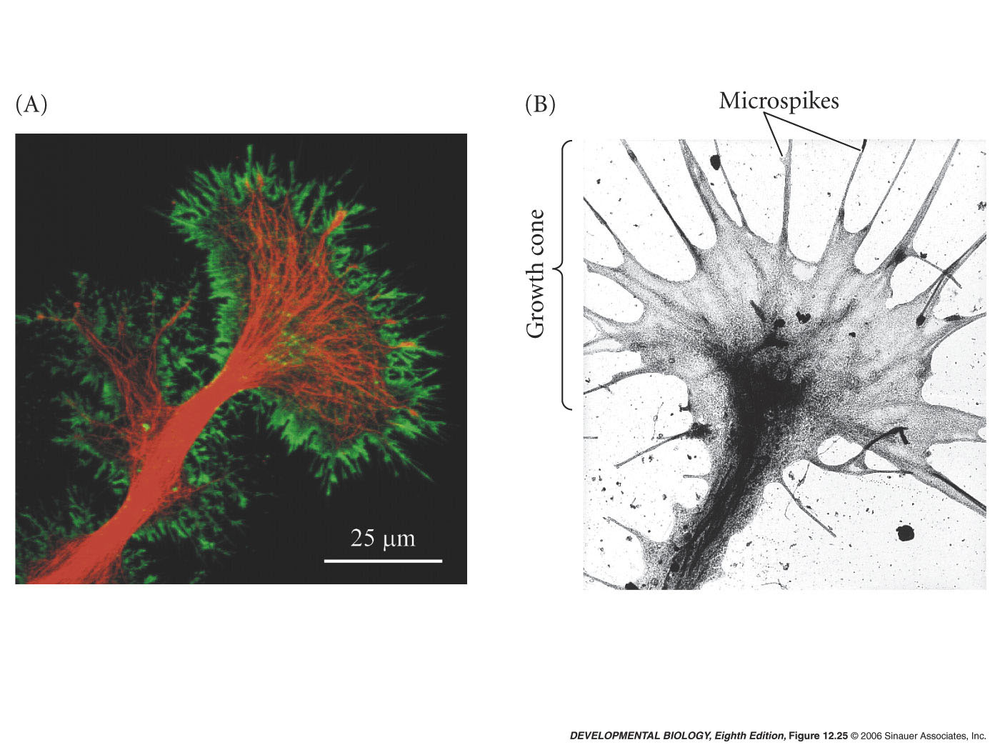
12.25 Axon growth cones
Notes:
devbio8e-fig-12-25-0.jpg

Slide 46
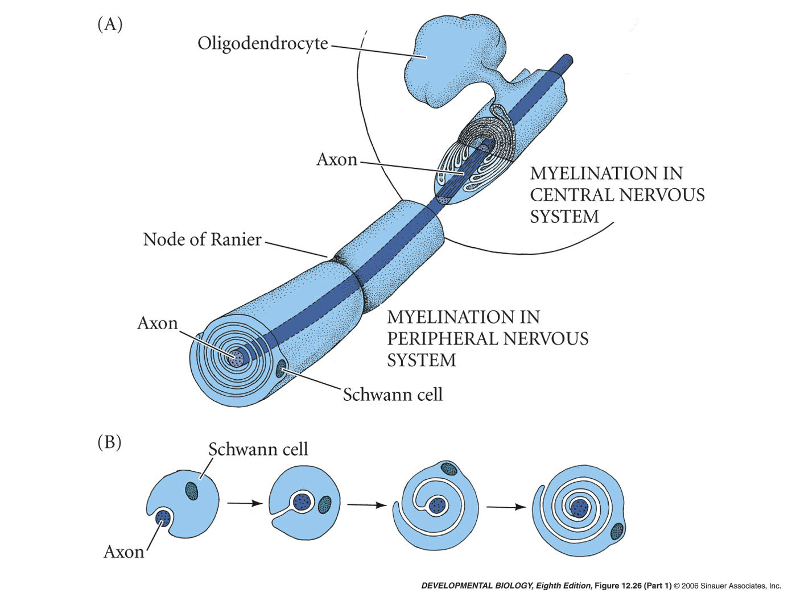
12.26 Myelination in the central and peripheral nervous systems (Part 1)
Notes:
devbio8e-fig-12-26-1.jpg

Slide 47
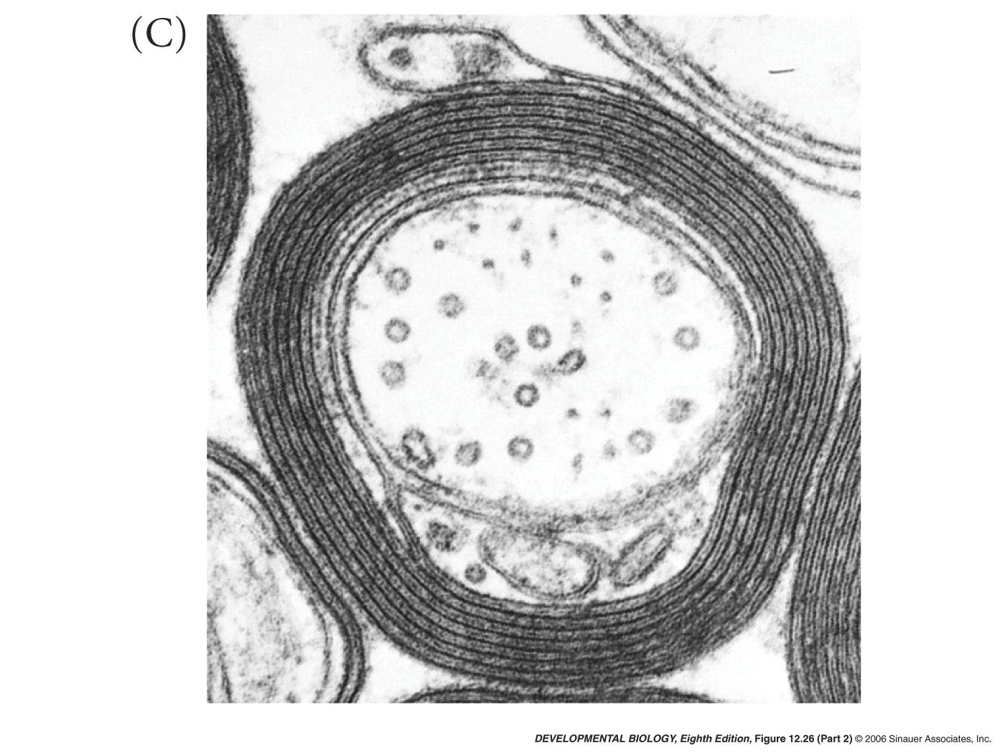
12.26 Myelination in the central and peripheral nervous systems (Part 2)
Notes:
devbio8e-fig-12-26-2.jpg

Slide 48
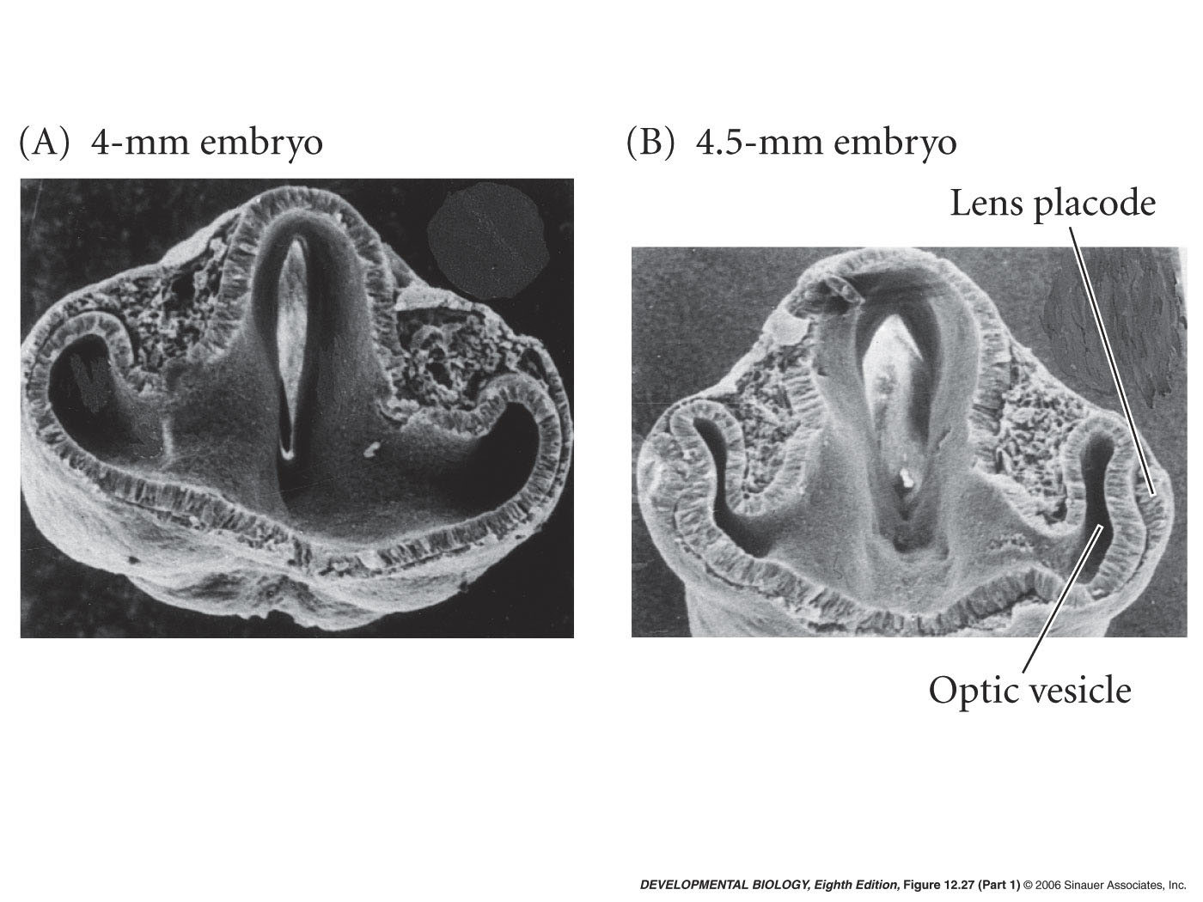
12.27 Development of the vertebrate eye (Part 1)
Notes:
devbio8e-fig-12-27-1.jpg

Slide 49
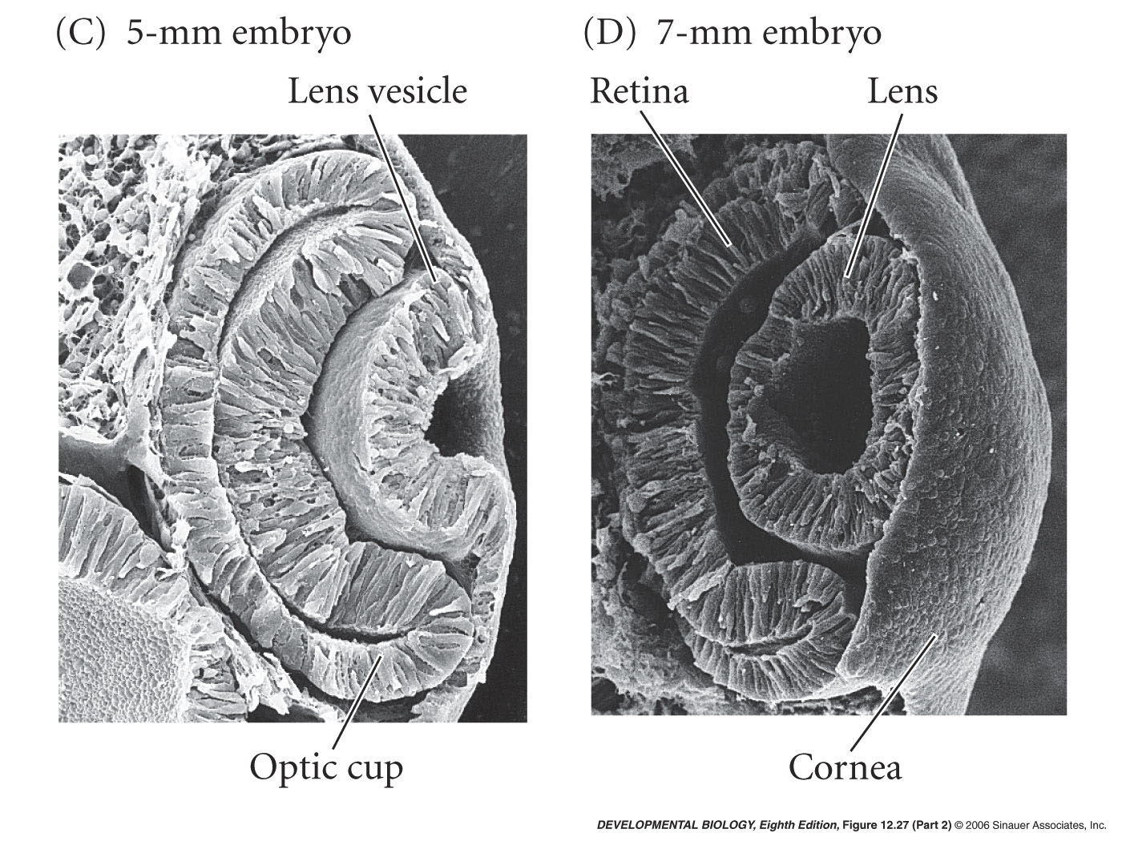
12.27 Development of the vertebrate eye (Part 2)
Notes:
devbio8e-fig-12-27-2.jpg

Slide 50
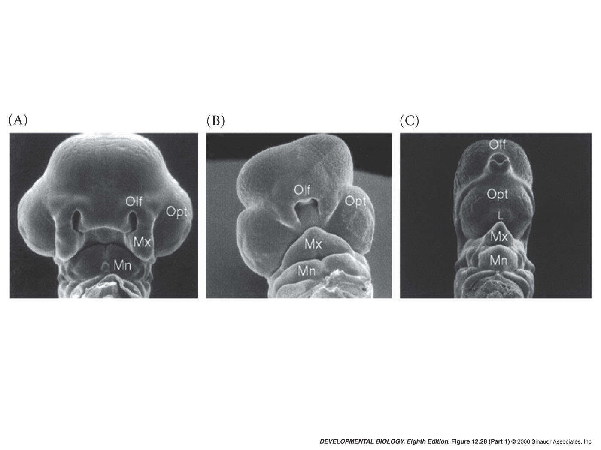
12.28 Sonic hedgehog separates the eye field into two bilateral fields (Part 1)
Notes:
devbio8e-fig-12-28-1.jpg

Slide 51
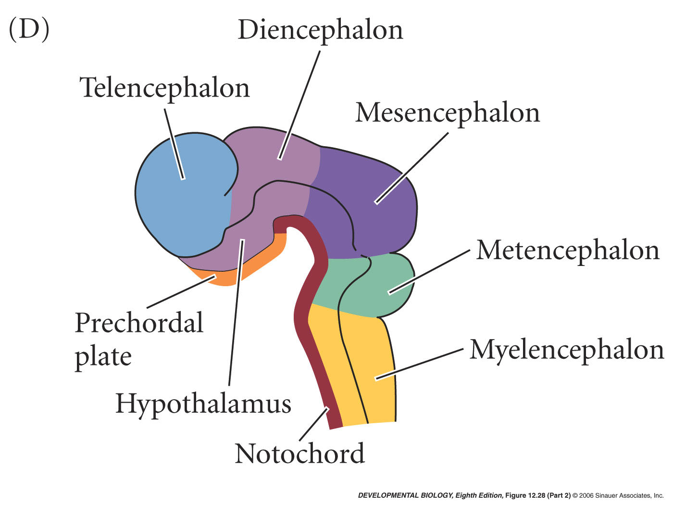
12.28 Sonic hedgehog separates the eye field into two bilateral fields (Part 2)
Notes:
devbio8e-fig-12-28-2.jpg

Slide 52
12.29 Surface-dwelling (A) and cave-dwelling (B) Mexican tetras (Astayanax mexicanum)
Notes:
devbio8e-fig-12-29-0.jpg

Slide 53
12.30 Expression of the Rx genes in vertebrate retina development (Part 1)
Notes:
devbio8e-fig-12-30-1.jpg

Slide 54
12.30 Expression of the Rx genes in vertebrate retina development (Part 2)
Notes:
devbio8e-fig-12-30-2.jpg

Slide 55
12.31 Retinal neurons sort out into functional layers during development
Notes:
devbio8e-fig-12-31-0.jpg

Slide 56
12.32 Differentiation of the lens and the anterior portion of the mouse eye (Part 1)
Notes:
devbio8e-fig-12-32-1.jpg

Slide 57
12.32 Differentiation of the lens and the anterior portion of the mouse eye (Part 2)
Notes:
devbio8e-fig-12-32-2.jpg

Slide 58
12.32 Differentiation of the lens and the anterior portion of the mouse eye (Part 3)
Notes:
devbio8e-fig-12-32-3.jpg

Slide 59
12.33 Layers of the human epidermis
Notes:
devbio8e-fig-12-33-0.jpg

Slide 60
12.34 Early development of the hair follicle and hair shaft (Part 1)
Notes:
devbio8e-fig-12-34-1.jpg

Slide 61
12.34 Early development of the hair follicle and hair shaft (Part 2)
Notes:
devbio8e-fig-12-34-2.jpg

Slide 62
12.34 Early development of the hair follicle and hair shaft (Part 3)
Notes:
devbio8e-fig-12-34-3.jpg

