Slide 1
Paraxial and Intermediate mesoderm
Gilbert Ch 17 539-580
Paraxial mesoderm
Gilbert Ch 12:
Paraxial and intermediate mesoderm
P415-432

Slide 2
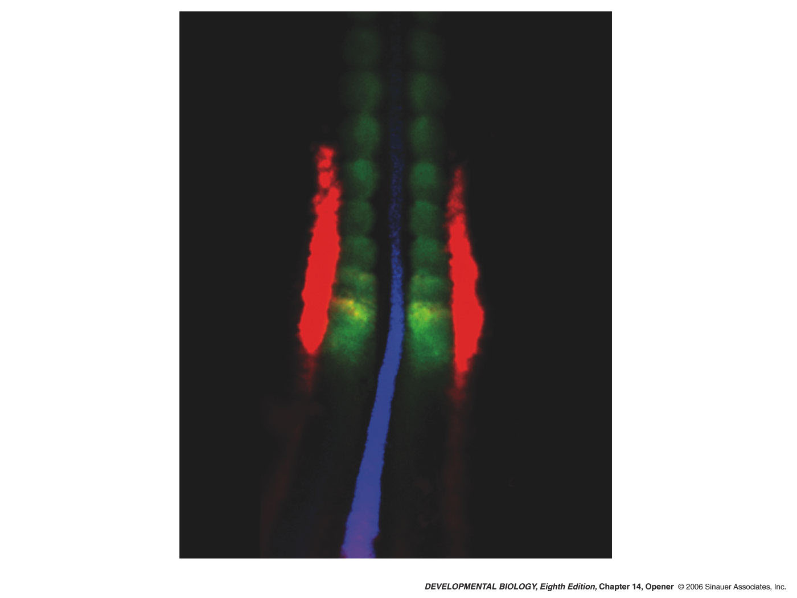
Chick 12 somite (33 hrs)
Chordin Blue (NC)
Paraxis Green (Som)
Pax2 Red (Int Mes)
Notes:
devbio8e-chptopener-14.jpg

Slide 3
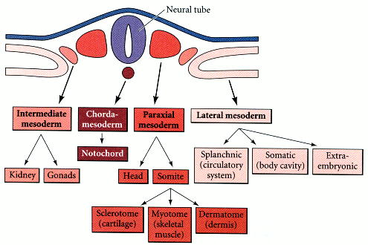
Lineages of the mesoderm

Slide 4
Neural tube and somites

Slide 5
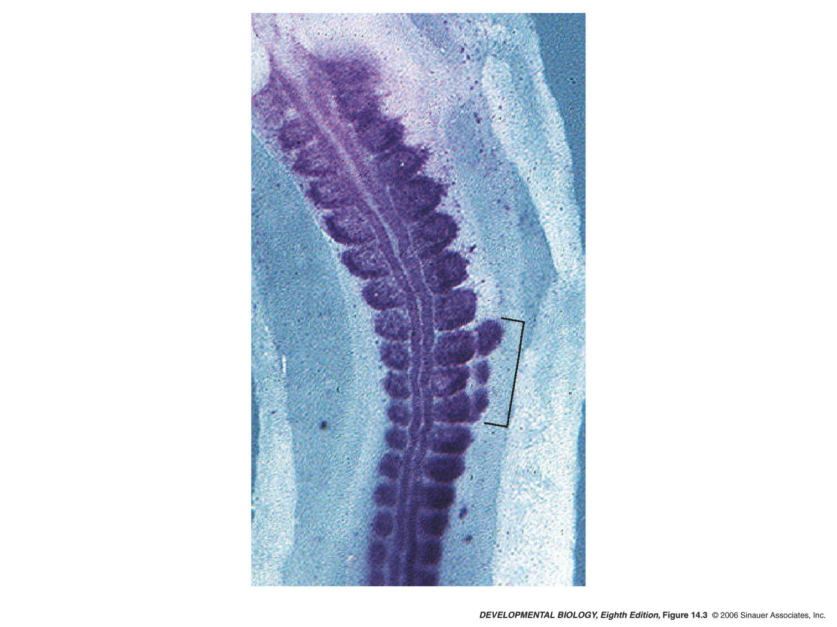
14.3 Specification of somites
Noggin expressing cells
In lateral plate meso
Induces somite like
Structures (pax3 +)
Notes:
devbio8e-fig-14-03-0.jpg

Slide 6
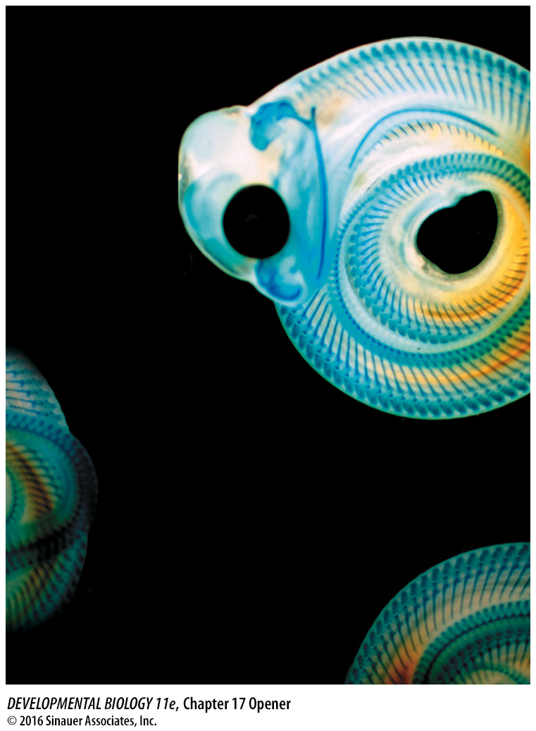
Notes:
Chapter 17 Opener What, when, where, and how many?

Slide 7
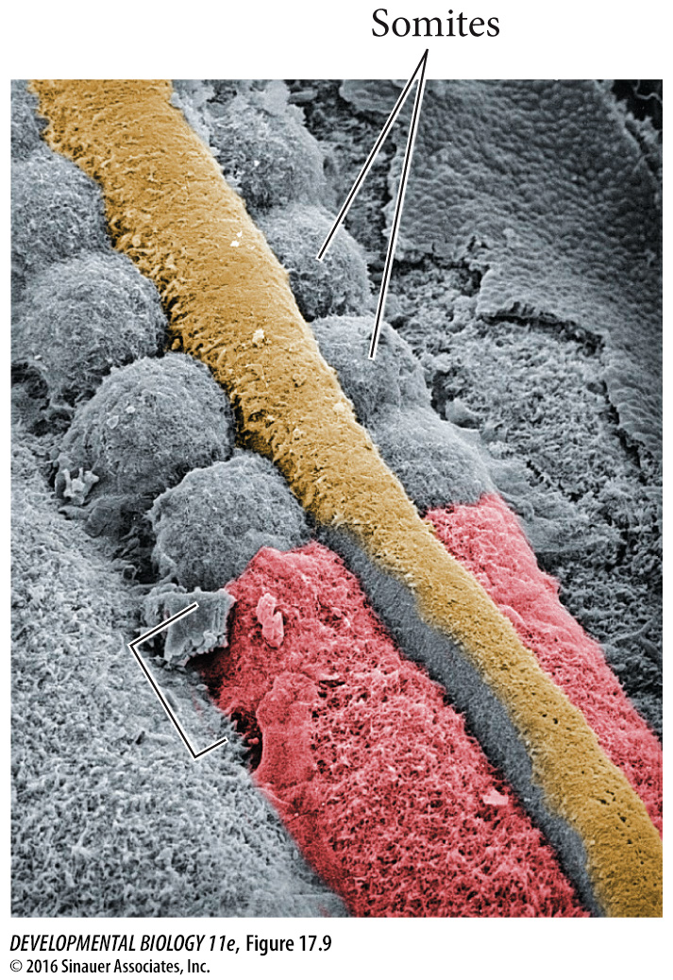
Notes:
Figure 17.9 Neural tube and somites seen by scanning electron microscopy. When the surface ectoderm is peeled away, well-formed somites are revealed, along with paraxial mesoderm (bottom right) that has not yet separated into distinct somites. A rounding of the paraxial mesoderm into a somitomere (area inside brackets) is seen at the lower left, and neural crest cells can be seen migrating ventrally from the roof of the neural tube. (Courtesy of K. W. Tosney.)

Slide 8
Mesenchymal to Epithelial Transition from somitomere to somite
N- Cadherin staining (white)

Slide 9
Transition from somitomere to somite
Paraxis staining in red

Slide 10
Transition from somitomere to somite
EphA4:
RTK
Ephrin B2 :
Ligand
border

Slide 11
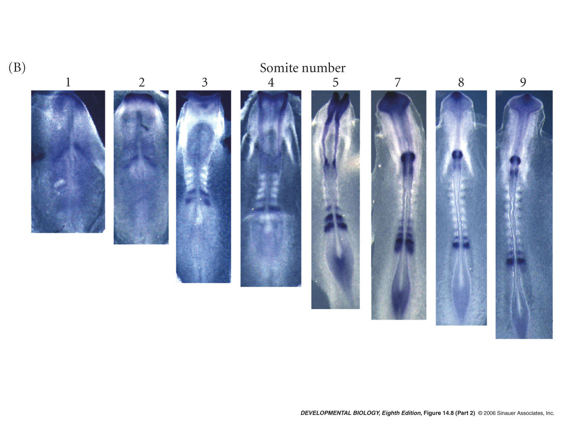
In Situ Ephrin A4 (blue) constitutes a possible cut site for somite formation
Notes:
devbio8e-fig-14-08-2.jpg

Slide 12
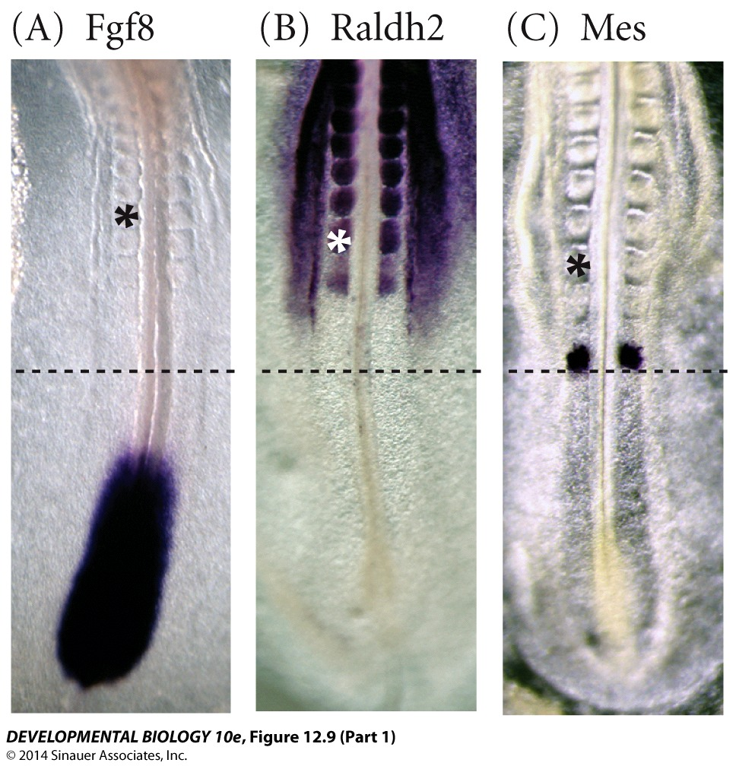
Figure 12.9 Possible model of “clock and wavefront” somite specification

Slide 13
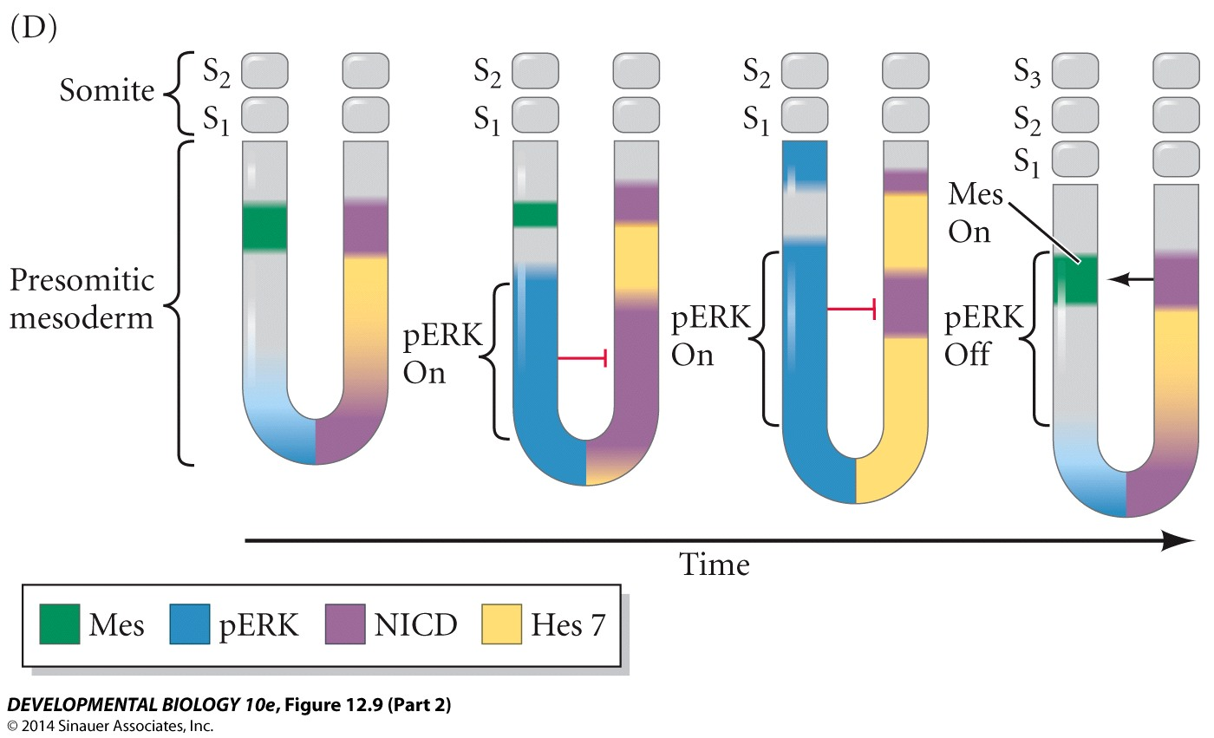
Figure 12.9 Possible model of “clock and wavefront” somite specification

Slide 14
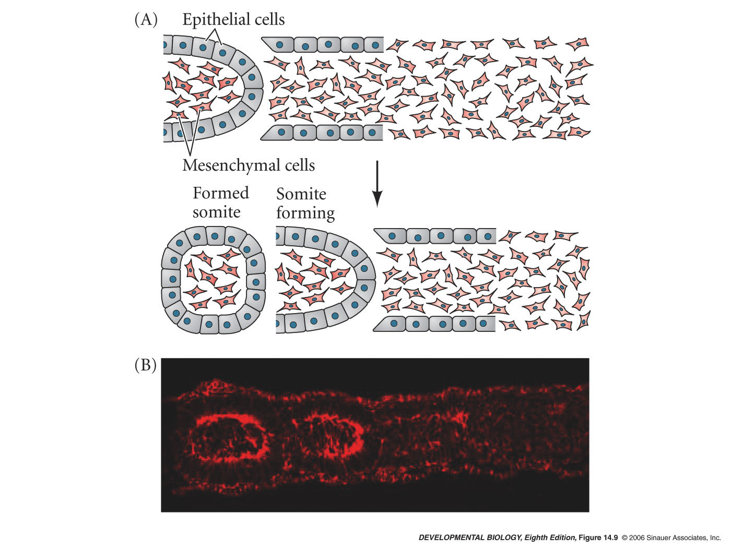
14.9 Epithelialization and de-epithelialization in somites of a chick embryo
F-Actin
Notes:
devbio8e-fig-14-09-0.jpg

Slide 15
The segmental plate mesoderm
Cervical
vertebrae
Vertebrae developing from donor tissue
Donor
tissue
Thoracic
vertebrae

Slide 16
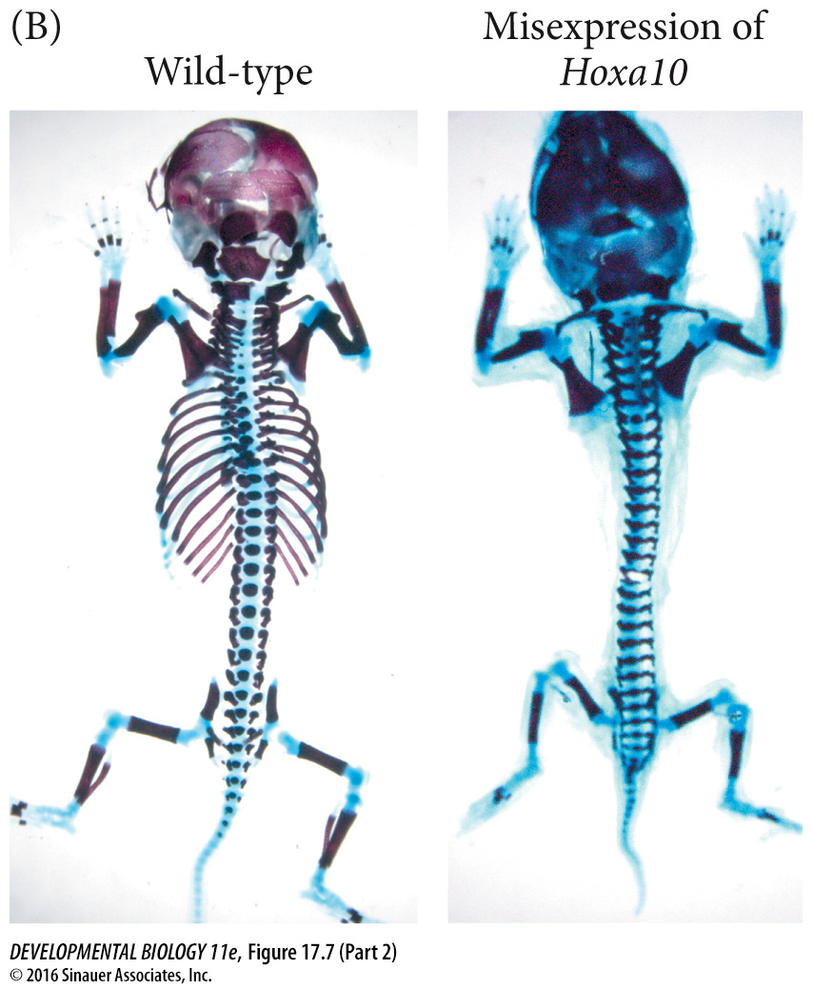
Notes:
Figure 17.7 Anterior-posterior specification of the somites. (A) When presomitic mesoderm (PSM) that would ordinarily form thoracic somites is transplanted into a region in a younger embryo (caudal to the first somite) that would ordinarily give rise to cervical (neck) somites, the grafted mesoderm differentiates according to its original position and forms ribs in the neck. (B) A mouse lacking ribs is formed when the Hoxa10 gene is expressed throughout the presomitic mesoderm. (C) A “snakelike” mouse, having ribs on every vertebra, is formed when the Hoxb6 gene is expressed throughout the presomitic mesoderm. (A after Kieny et al. 1972; B from Vinagre et al. 2010, courtesy of M. Mallo; C from Casaca et al. 2016.)

Slide 17
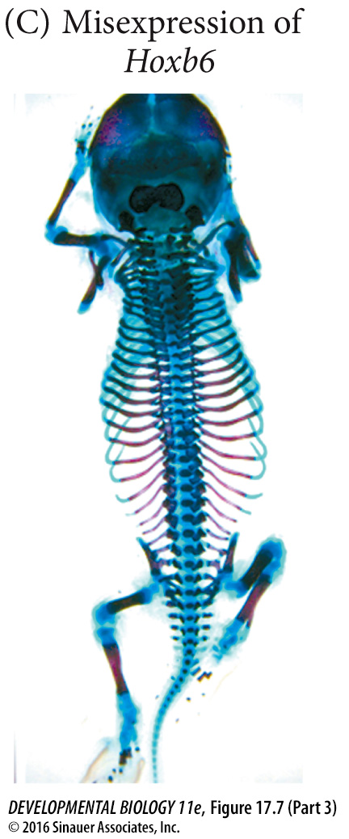
3)
Notes:
Figure 17.7 Anterior-posterior specification of the somites. (A) When presomitic mesoderm (PSM) that would ordinarily form thoracic somites is transplanted into a region in a younger embryo (caudal to the first somite) that would ordinarily give rise to cervical (neck) somites, the grafted mesoderm differentiates according to its original position and forms ribs in the neck. (B) A mouse lacking ribs is formed when the Hoxa10 gene is expressed throughout the presomitic mesoderm. (C) A “snakelike” mouse, having ribs on every vertebra, is formed when the Hoxb6 gene is expressed throughout the presomitic mesoderm. (A after Kieny et al. 1972; B from Vinagre et al. 2010, courtesy of M. Mallo; C from Casaca et al. 2016.)

Slide 18
Diagram of a transverse section through the trunk of a chick embryo
2-day embryo
3-day embryo

Slide 19
Diagram of a transverse section through the trunk of a chick embryo on days 24
4-day embryo
Late 4-day embryo

Slide 20
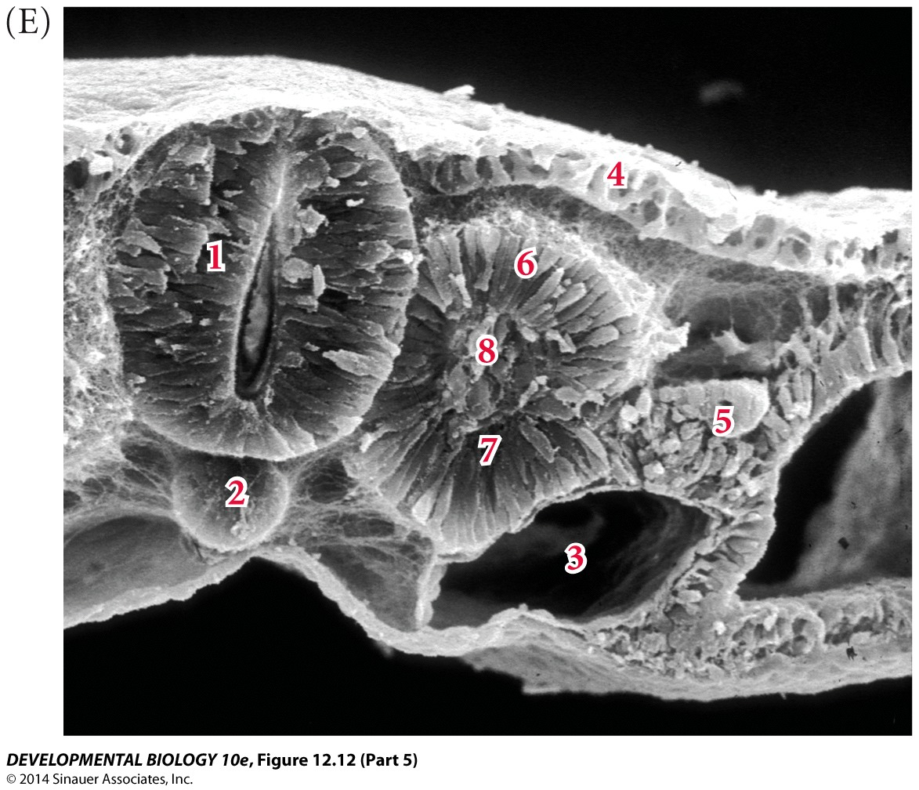
Figure 12.12 Transverse section through the trunk of a chick embryo on days 2–4

Slide 21
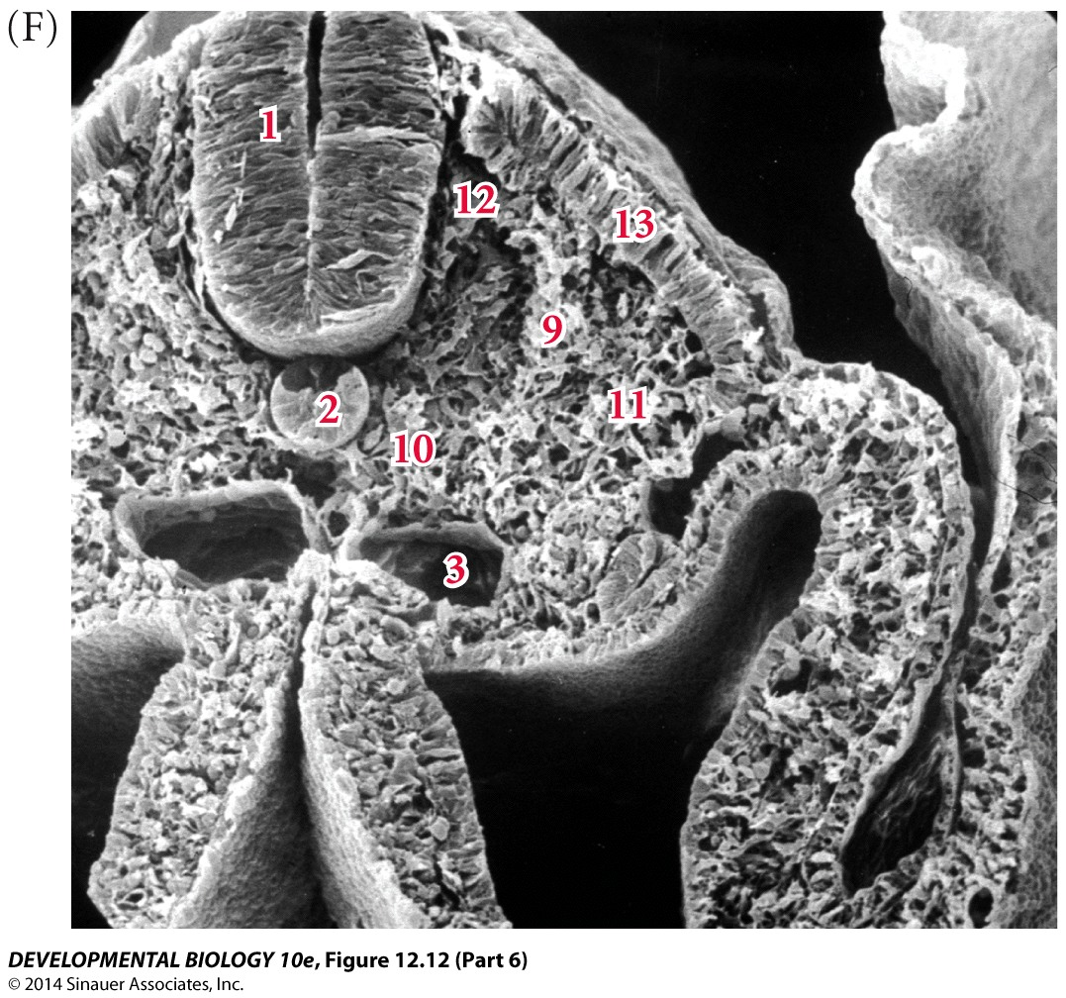
Figure 12.12 Transverse section through the trunk of a chick embryo on days 2–4

Slide 22
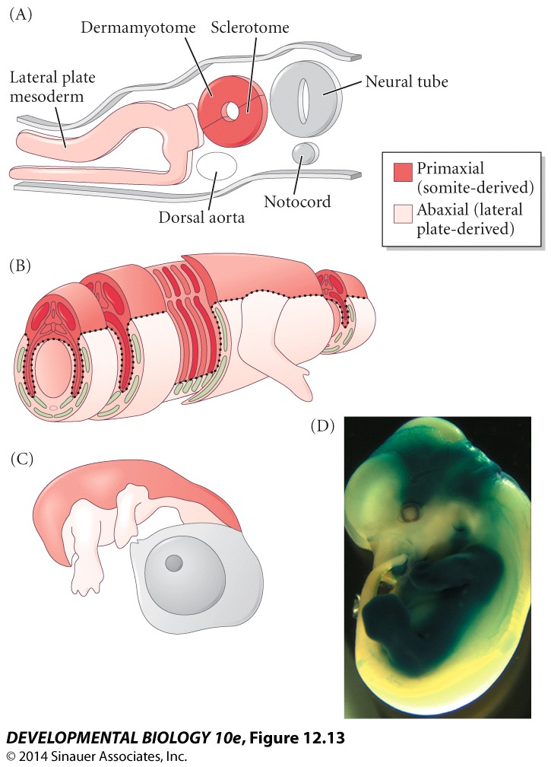
Figure 12.13 Primaxial and abaxial domains of vertebrate mesoderm

Slide 23
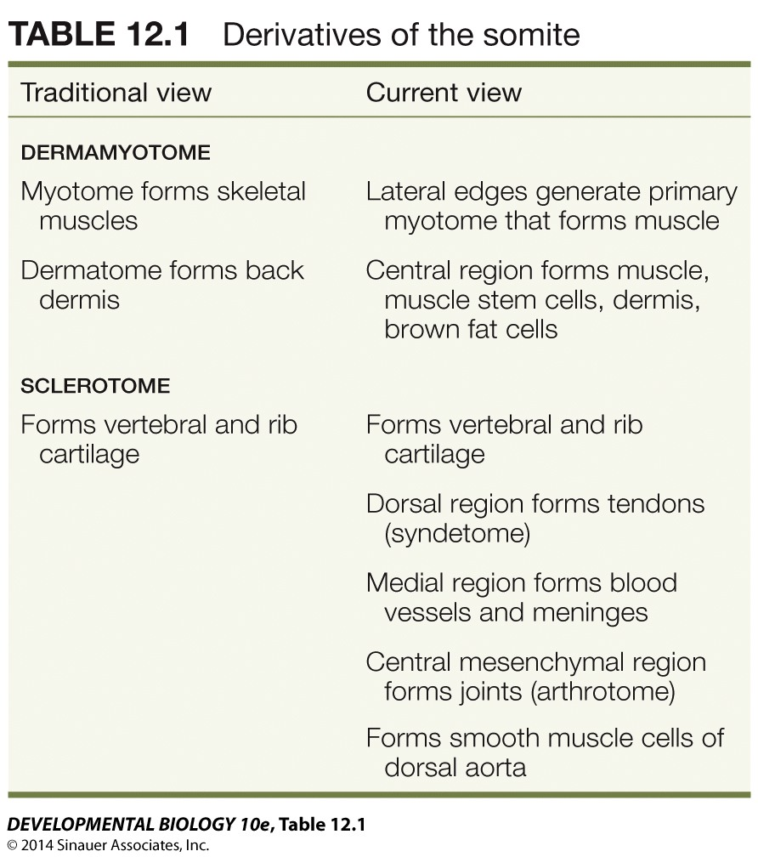

Slide 24
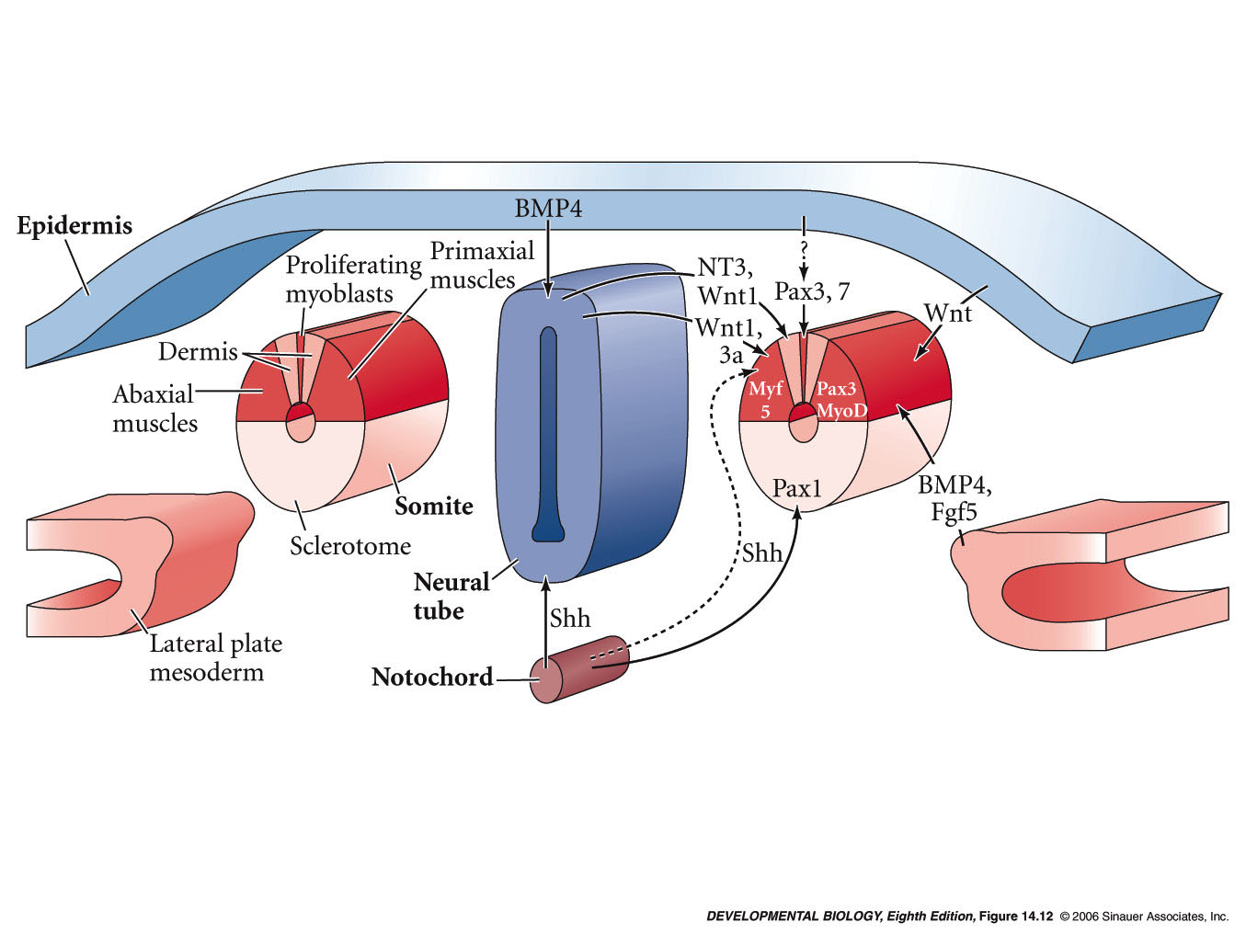
interactions in the patterning of the somite
Notes:
devbio8e-fig-14-12-0.jpg

Slide 25
Conversion of myoblasts into muscles in culture

Slide 26
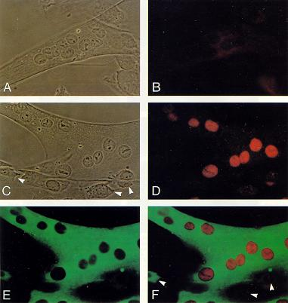

Slide 27
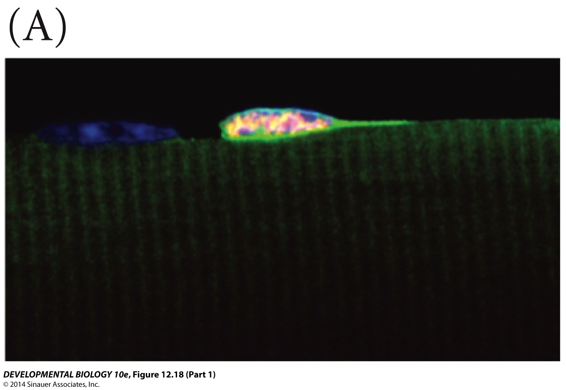
Figure 12.18 Satellite cells and muscle growth

Slide 28
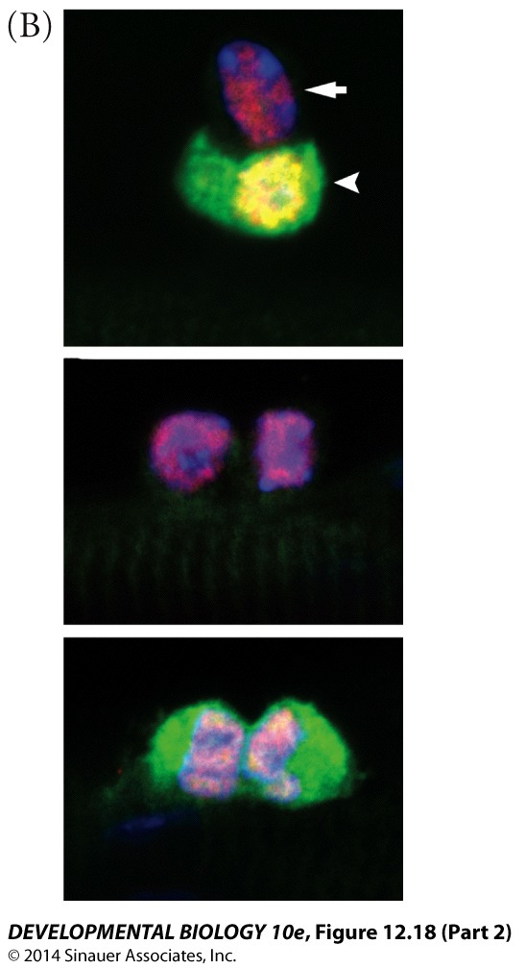
Figure 12.18 Satellite cells and muscle growth

Slide 29
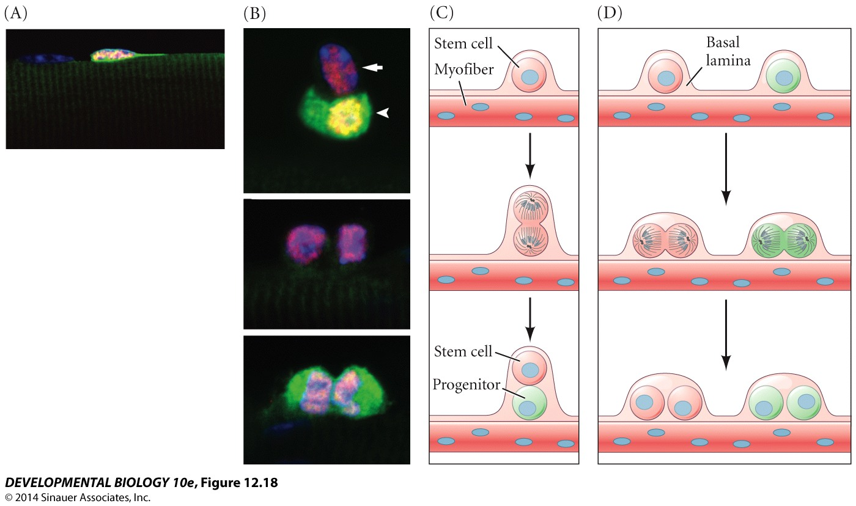
Figure 12.18 Satellite cells and muscle growth

Slide 30
Myotome derivatives of the mouse embryo

Slide 31
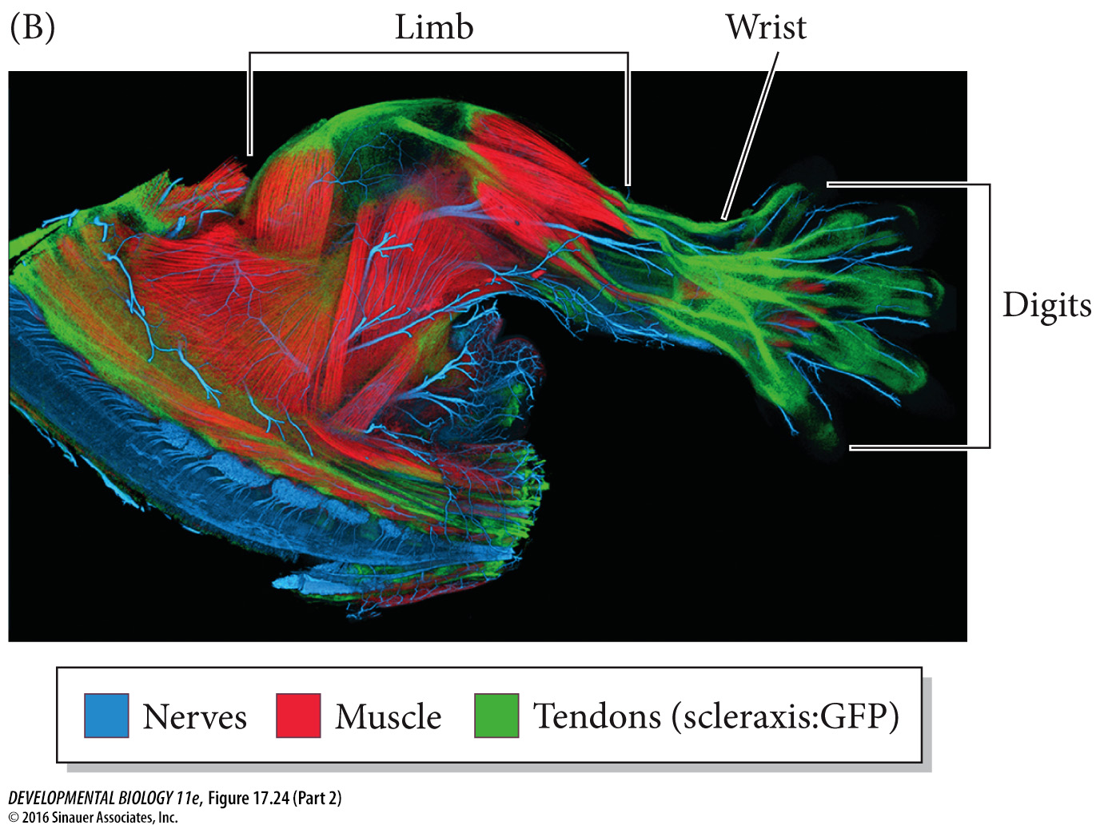
Figure 17.24 Scleraxis is expressed in the progenitors of the tendons
Notes:
Figure 17.24 Scleraxis is expressed in the progenitors of the tendons. (A) In situ hybridization showing the pattern of scleraxis expression in the developing chick embryo. (B) Limb, wrist, and digits of a newborn mouse, showing scleraxis (fused to GFP) in the tendons (green) connecting muscles (stained red with antibodies to myosin). The neurons have been stained blue by antibodies to neurofilament proteins. (A from Schweitzer et al. 2001, courtesy of R. Schweitzer; B courtesy of A. K. Lewis and G. Kardon.)

Slide 32
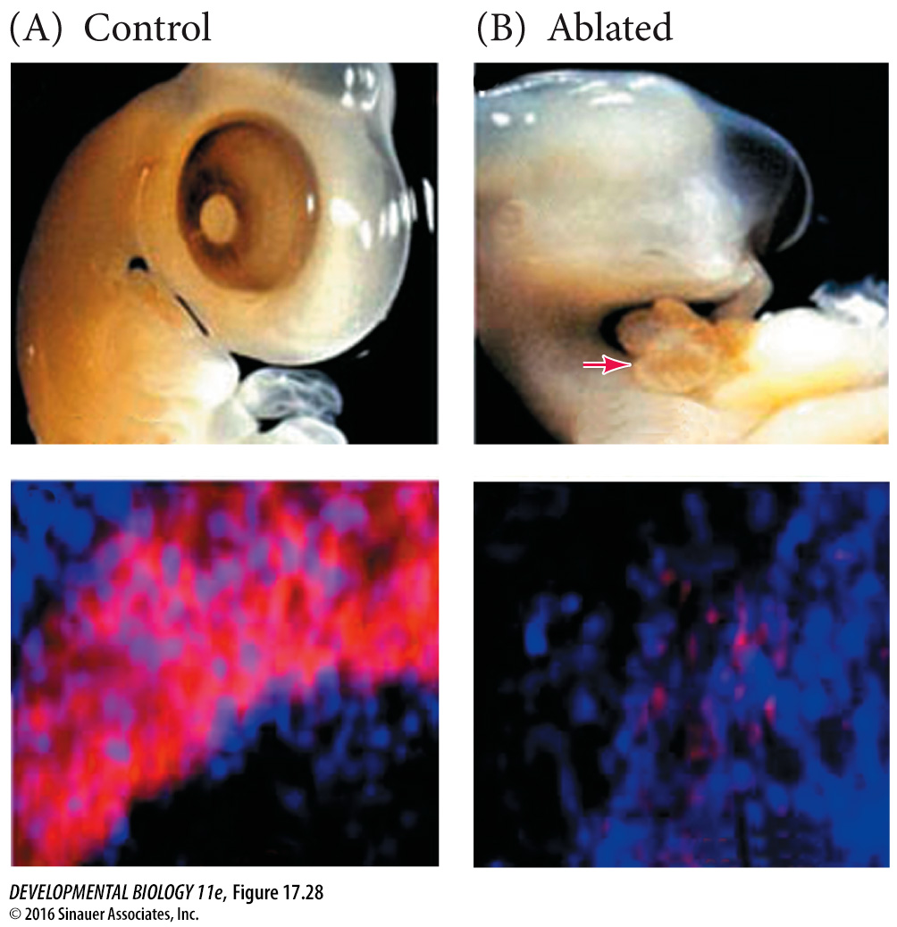
Notes:
Figure 17.28 Ablating Noggin-secreting epiblast cells results in severe muscle defects. Noggin-secreting epiblast cells were ablated in stage 2 chick embryos using antibodies against G8. (A) The control embryo has normal morphology (upper photograph) and abundant staining of myosin (lower photograph, red) in the muscles. (B) Embryos whose Noggin-secreting epiblast cells are ablated have severe eye defects, severely reduced somatic musculature, and herniation of abdominal organs through the thin abdominal wall (upper photograph, arrow). Severely reduced musculature (sparse myosin in lower photograph) is characteristic of these embryos. (From Gerhart et al. 2006, courtesy of J. Gerhart and M. George-Weinstein.)

Slide 33
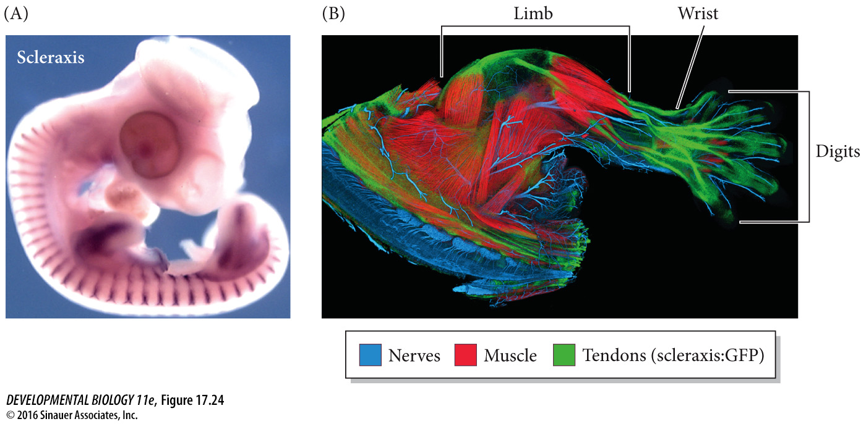
Notes:
Figure 17.24 Scleraxis is expressed in the progenitors of the tendons. (A) In situ hybridization showing the pattern of scleraxis expression in the developing chick embryo. (B) Limb, wrist, and digits of a newborn mouse, showing scleraxis (fused to GFP) in the tendons (green) connecting muscles (stained red with antibodies to myosin). The neurons have been stained blue by antibodies to neurofilament proteins. (A from Schweitzer et al. 2001, courtesy of R. Schweitzer; B courtesy of A. K. Lewis and G. Kardon.)

Slide 34
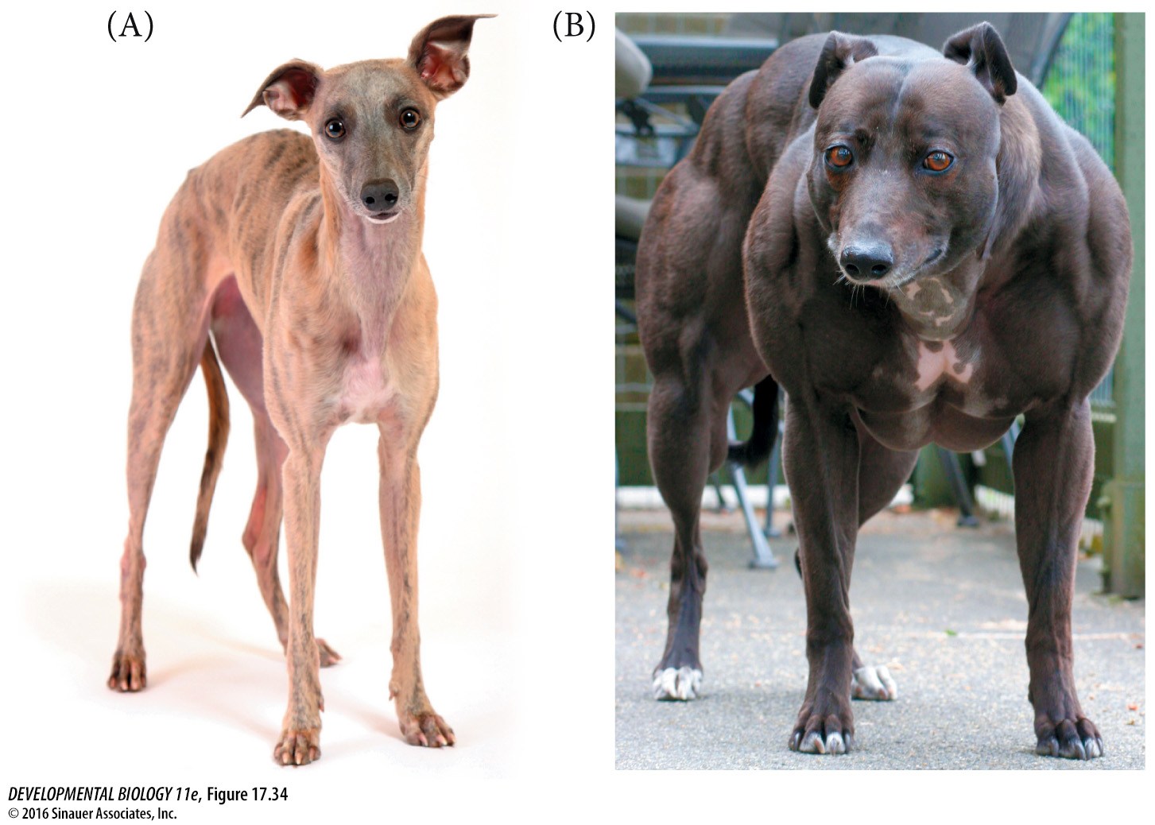
Figure 17.34 A loss-of-function mutation in the myostatin gene of whippets
Notes:
Figure 17.34 A loss-of-function mutation in the myostatin gene of whippets. (A) Whippets are a typically slender breed, bred for speed and dog racing. (B) Although the homozygous loss-of-function condition is not advantageous, heterozygotes have more muscle power and are significantly overrepresented among the top racers (see Mosher et al. 2007). (A © kustudio/Shutterstock; B © Bruce Stotesbury/PostMedia News/Zuma Press.)

Slide 35
Conversion of myoblasts into muscles in culture

